Slide 1


Fitness as part of the healthcare solution
CEEHFS, Prague 20th October 2023
Andreas Paulsen, CEO, EuropeActive

Slide 2

Health
Digital
Community
Standards

Slide 3


Slide 4


Slide 5





Our political representation

Slide 6

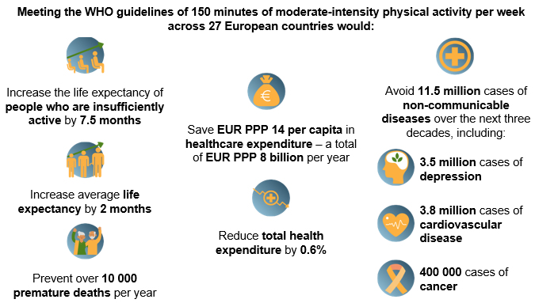

Slide 7

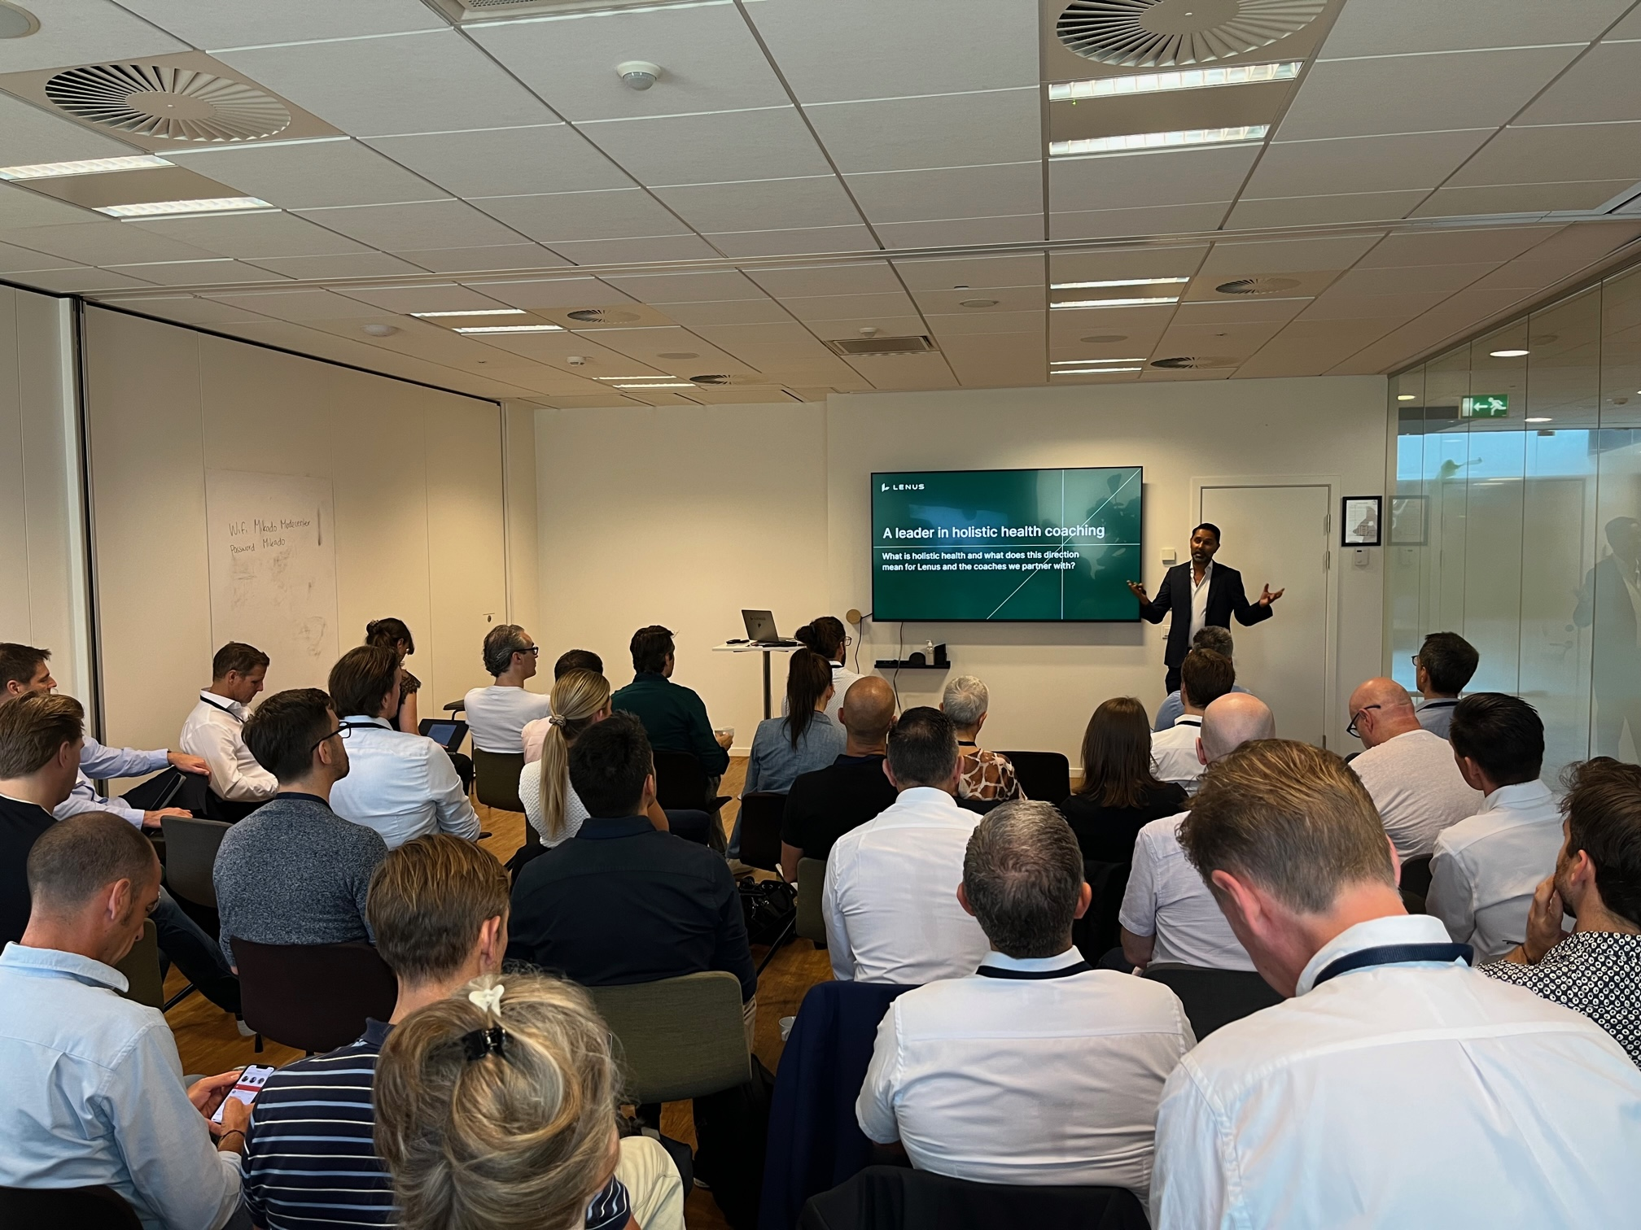

Slide 8


Slide 9

The skillsFIT Programme 2023 – 2030
A strategic plan for the European
fitness sector workforce

Slide 10


Slide 11


Slide 13

Thanks for your attention
Q&A

