Slide 1
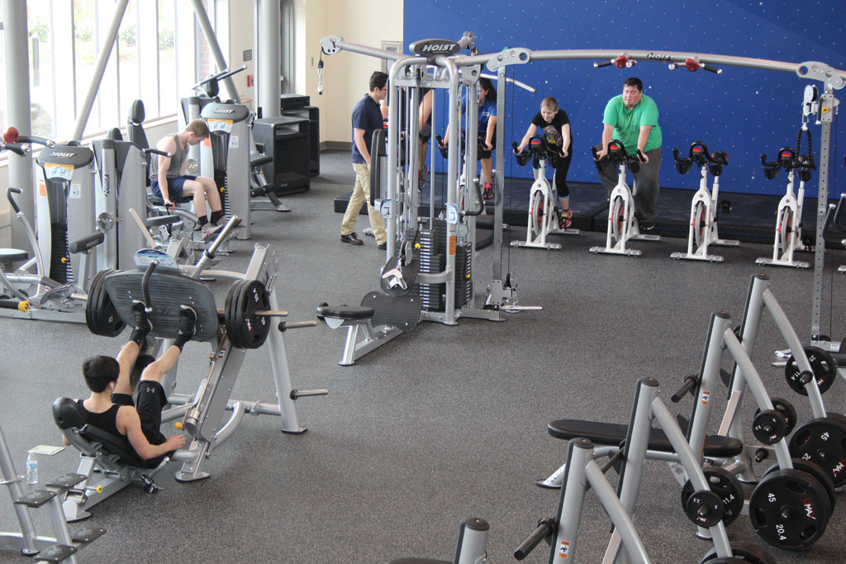


FITcert®, Elevating Fitness Clubs to the Highest Standard
Kiwa Gert-Jan Kieft Praha, October 20 2023
This Photo by Unknown Author is licensed under CC BY-NC-ND

Slide 2









Who we are
Kiwa is
Globally
active
Founded 1948
in the Netherlands
Part of the
SHV Family of Companies
Kiwa has
Offices in 40
countries
A partner and agent network
An operating income
of € 629m in 2021
~10,000
employees

Slide 3








What we do
We create trust
Testing
Inspection
Certification
There is a strict
separation between
our certification services
and activities like training
courses and consultancy
Training
Consultancy
Data services

Slide 4



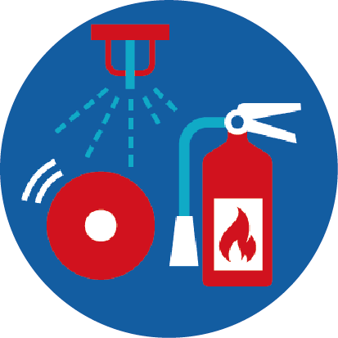






Markets
Food, Feed, Farm
Construction
Fire
Safety
Industry
Assets
plus many more
Medical
Devices
(Renewable)
Energy
Water
Radio and
Wireless

Slide 5









Why we do it
We ensure
Quality
Safety
Health
Sustainability
for
Your customers
or clients
Your
employees
Society
Our living
environment

Slide 6

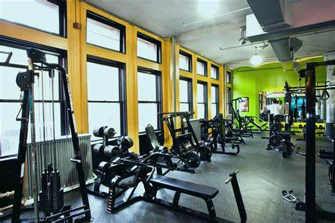
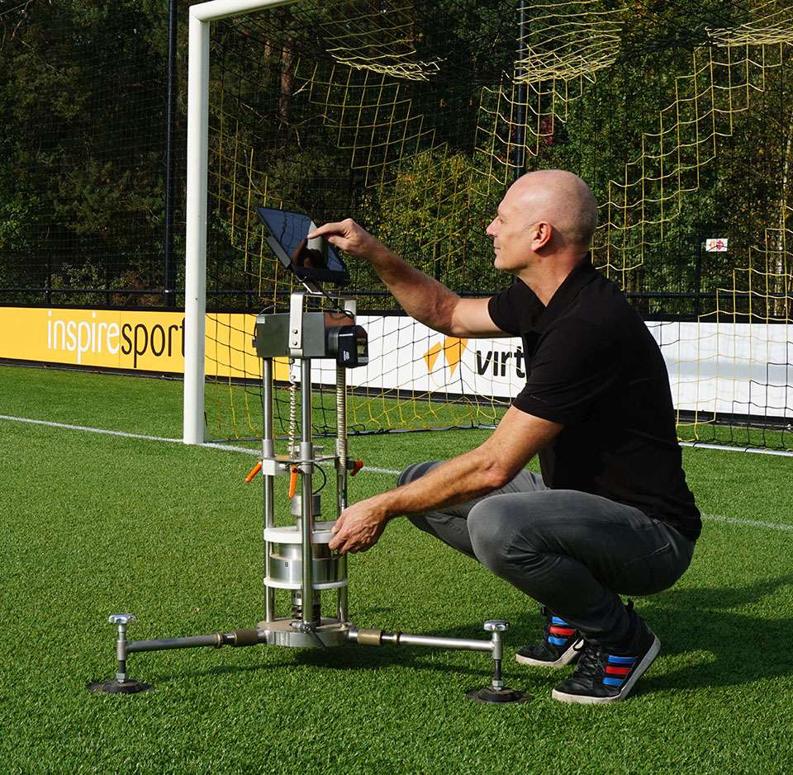
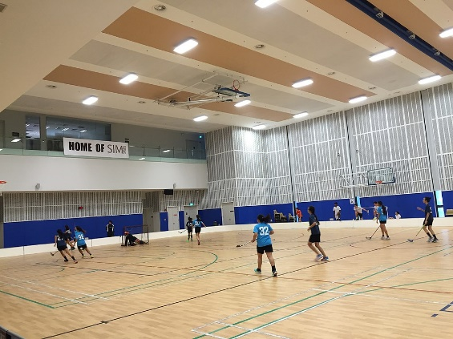
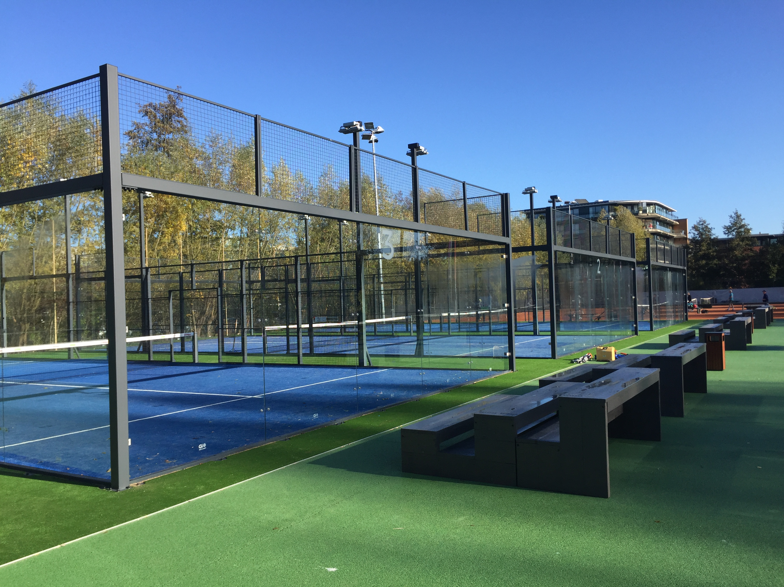
KIWA ISA Sport
Testing, Inspection and Consultancy of Sports Facilities
For quality, safety, durability and sustainability!
This Photo by Unknown Author is licensed under CC BY-SA

Slide 7









International accreditations

Slide 8


Welcome to fitCERT.eu | www.fitcert.eu

Slide 9
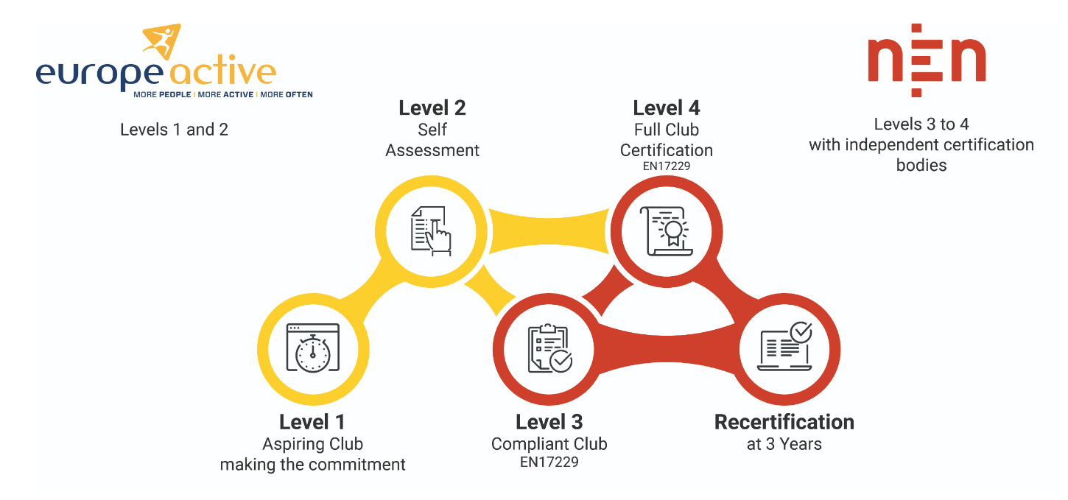

Slide 10
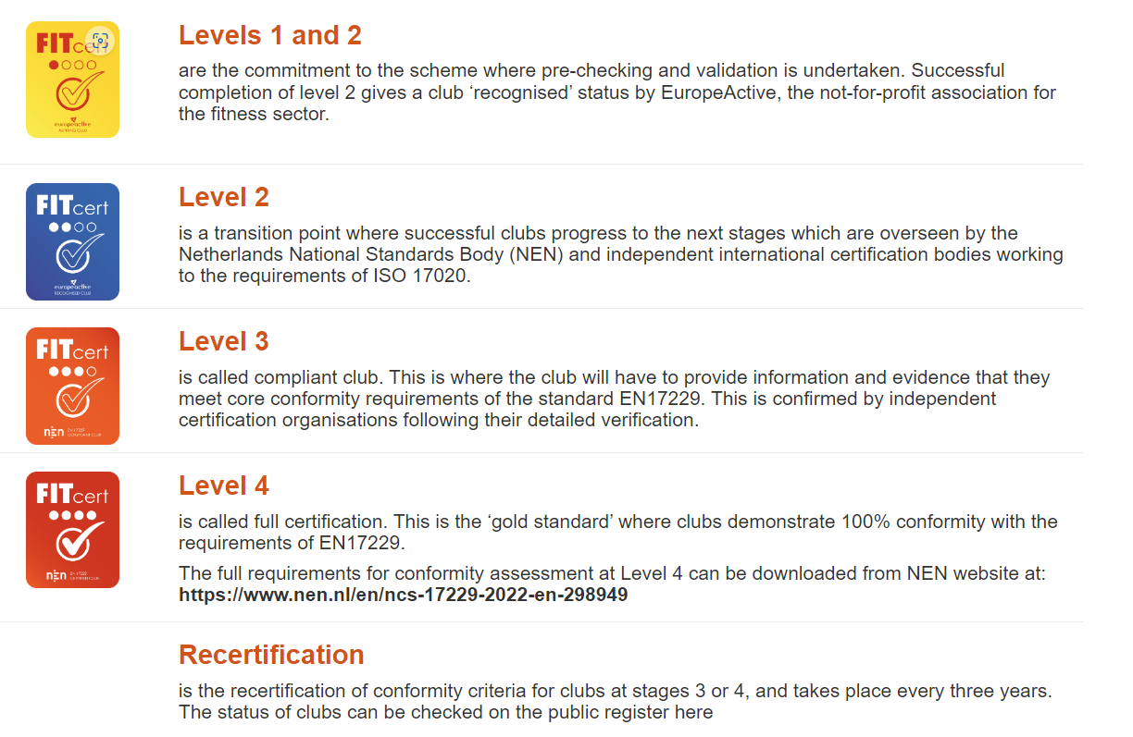
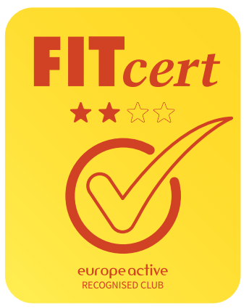

Slide 11
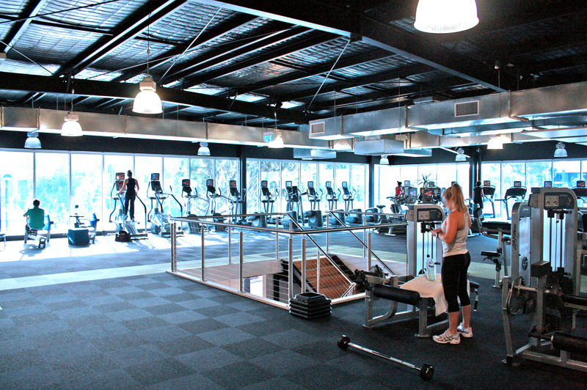
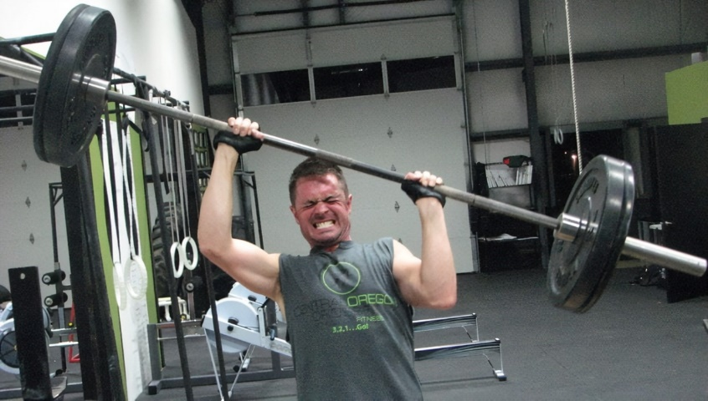
Level 1- Entering the ‘Waiting Room’
Club signs a commitment to enter the certification scheme
Club submits contact details, web site, services, size, etc.
Club receives:
  The full scheme requirements and a step-by-step programme and guide
  A statement recognizing that they have entered the scheme
The club can inform its members and users that it has made the commitment

Slide 12
Level 2
Club confirms delivery of its services, operations and management based on 15 questions covering core requirements (currently of Part 1 of EN 17229)
Club provides basic documentation and/or links to substantiate its confirmation
EuropeActive oversees receipt and checking by an industry expert
Club receives:
  Confirmation that they are now a EuropeActive Recognised Club
  Clearance to move to stage 3 and the NEN certification scheme
  Listing on the public register at FITcert.eu
The club can inform its members and users and can display unique certificate of a recognised club

Slide 13
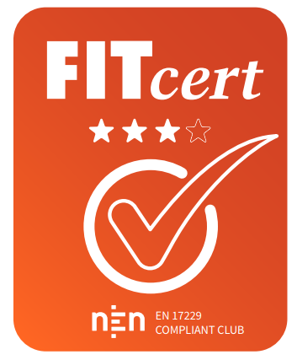
Level 3
Independent conformity assessment against core criteria (EN 17229-1)
On-line questionnaire of 35-50 questions with supporting documents
Certification body verifies conformity through on-line process and video-conferencing
Club receives:
  EN 17229 Compliant Club certificate issued by NEN, certification body and EuropeActive
  Status changed on NEN scheme website
The club informs its members and users and can display unique certificate of an EN 17229 compliant club
Conformity assessment lasts for 3 years with re-certification at 2 years
Club is informed of changes and updates to standards

Slide 14
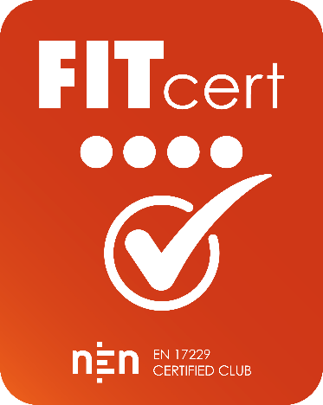
Level 4 - Full Club Certification – the gold standard
Clubs can stop at stage 3 with conformity assessment
European Certification is achieved at stage 4
Stage 4 to be completed within 1 year of stages 2 or 3
Independent assessment against all conformity criteria (EN 17229-1)
Certification body verifies conformity through on-line process, video-conferencing and on-site inspection
Club receives:
  EN 17229 Certified Club certificate issued by NEN and certification body
  EuropeActive recognition as a Gold Standard Club
  Status changed on NEN scheme website and priority listing
Certification lasts for 3 years with re-validation at 2 years
Club is informed of changes and updates to standards

Slide 15



Licenced inspection bodies

Slide 16
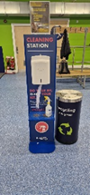
EN 17229 Certification scheme
Operational and managerial requirements
4.1 | Contract/contractual obligations
 | Code of use (user terms and conditions): - duration of the contract; - terms of payment; - extension of the time limit; - termination or suspension; - terms of use (expected behavior of customer); - services offered; - limitation of liability in the provision of services; - insurance obligations and indemnities by the operator; - compliance with data protection; the times when the club is physically supervised

Slide 17
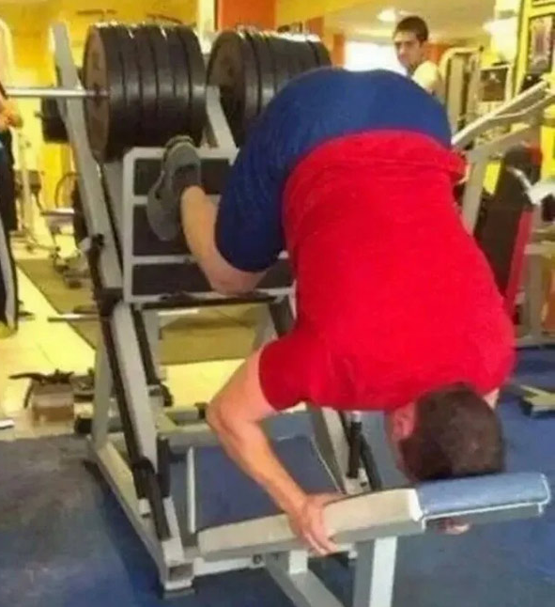
EN 17229 Certification scheme
Operational and managerial requirements
4.2 | User Care
 | User care – general New or returning users are given a tour and/or by written, displayed or digital information that explains its safe use. declaration for the safe and correct use of all training equipment. information about using other facilities to ensure that users are kept safe.

Slide 18
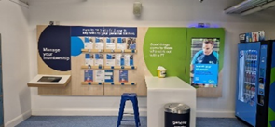
EN 17229 Certification scheme
Operational and managerial requirements
4.2 | User Care
 | User relations customer feedback system; commitment to service delivery; encouraging user feedback; clearly stated response times; treating the customer fairly; ensuring supervision of users is consistent; Inform about improvements to services and faciliies

Slide 19
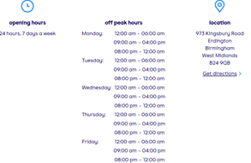
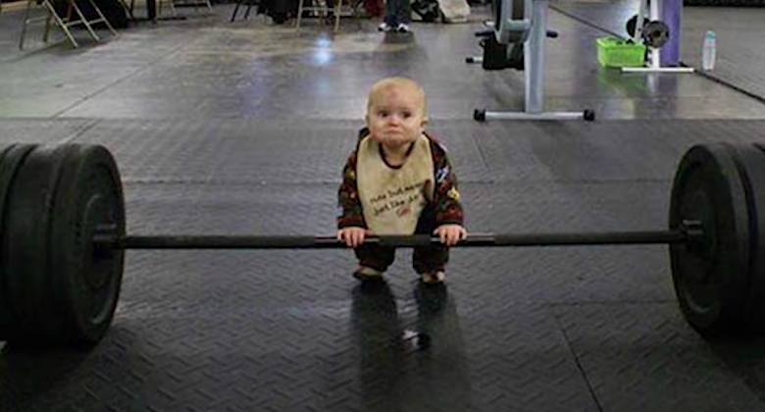
EN 17229 Certification scheme
Operational and managerial requirements
4.3 | Basic Service
 | The facilities’ opening hours are clearly displayed. The fees for use of the are clearly displayed The terms and conditions of use are clearly displayed
4.4 | Promoting active and healthy lifestyles Safe and healthy way of exercising, know what they do within their capabilities
Notes:
service

Slide 20
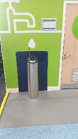
EN 17229 Certification scheme
Operational and managerial requirements
4.5 | Operation of the facility
 | Written procedures and policies on the overall operation Condition survey Maintenance Repair Complaints Staff training on procedures
 | Electric supply to equipment
 | Flooring/surfaces in exercising areas and corridors
 | Hygiene
 | Ventilation
 | Temperature
 | Lighting
 | Noise level
 | Hydration during exercising
Notes:
service

Slide 21
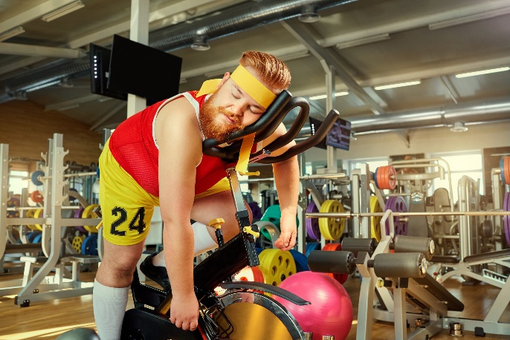
EN 17229 Certification scheme
Operational and managerial requirements
4.6 | Control of substances hazardous to health Avoid risk of contact Have written procedures about it Risk assessment
4.7 | Building installations or equipment Risk assessment of building and equipment Correct operation, maintenance, service
Notes:
service

Slide 22
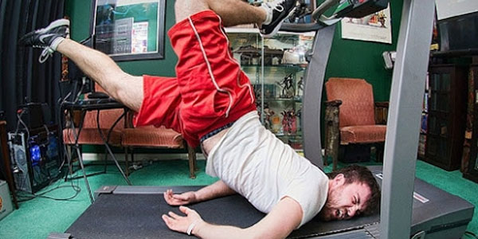
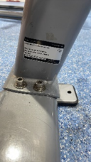
EN 17229 Certification scheme
Safety requirements
5.1 | Safety management system - general
 | Safety policy
 | Safety operating procedures
 | Emergency and safety-related events
 | Positioning of stationary training equipment
 | Selection of stationary training equipment
 | Care and maintenance of training equipment
 | Supervision of the facility

Slide 23
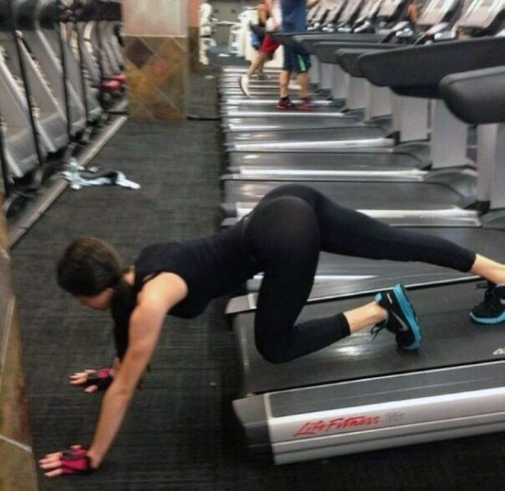
So, how to kick this off ?
Start up and finish stage 1 and 2 (contact EuropeActive)
Contact Licensed Body for entering stage 3 / 4
We will guide you through the process:
  on the deliverables
  about what to deliver and when
  how
Portal for entering the right documents
Remote audit will take place for stage 3
Audit on location will take place for stage 4
We take care the audit report is communicated with EuropeActive and a certificate is issued.

Slide 24


Contact
FITcert.eu | www.fitcert.eu
Home | www.europeactive.eu
Gert-Jan Kieft
gert-jan.kieft@kiwa.com
+31 6 5357 6434

