Slide 1


Behaviour Change That Works
Recruiting inactive participants into sport
Insights from behavioural science
CEEHFS 2023
Praha
Ian@thebehaviouralist.com

Slide 2
Behavioural Science
The science and study of how we behave and make decisions

Slide 3



What is behavioural science (how it can help)
1
People do not act as rational beings.
Behavioural science provides a more realistic perspective on how people make decisions.
‘Nudges’ and theories of change.
2
It is evidence based and data driven.
Robust evaluation (RCTs, A:B testing)
It can help build best practice and share and scale learnings.
3
Applied together this can increase your programmes / campaign impact.
It provides a lens to view a problem.
It has grown exponentially - across sectors. Sport has been a slow adopter.
Notes:
TED talks and materials.
Examples include new years resolutions.
Not switching bank accounts for charges – sunk costs.

Slide 4




Applying behavioural science to increase the start and continuation (sustain) of sport and physical activity in disadvantaged communities.
Notes:
Quicker – national govt sports organisation – elite and participation and public health.

Slide 5
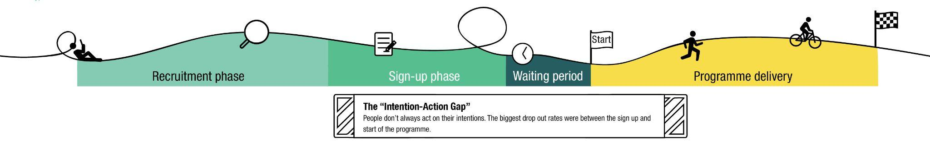
Programme design
Recruitment - what strategies are effective at recruiting inactive participants from areas of deprivation to physical activity (PA) programmes.
Pre-commitment devices - helping people to pre-commit to exercise has increased motivation and the likelihood to finish programmes.
Incentives (financial and non-financial) - can be used to attract participants onto programmes and to support them to complete their exercise goals.
Interventions to Increase Physical Activity in Disadvantaged Communities: A Review of Behavioural Mechanisms, (Gormley, Belton, Lunn & Robertson, 2019)

Slide 6
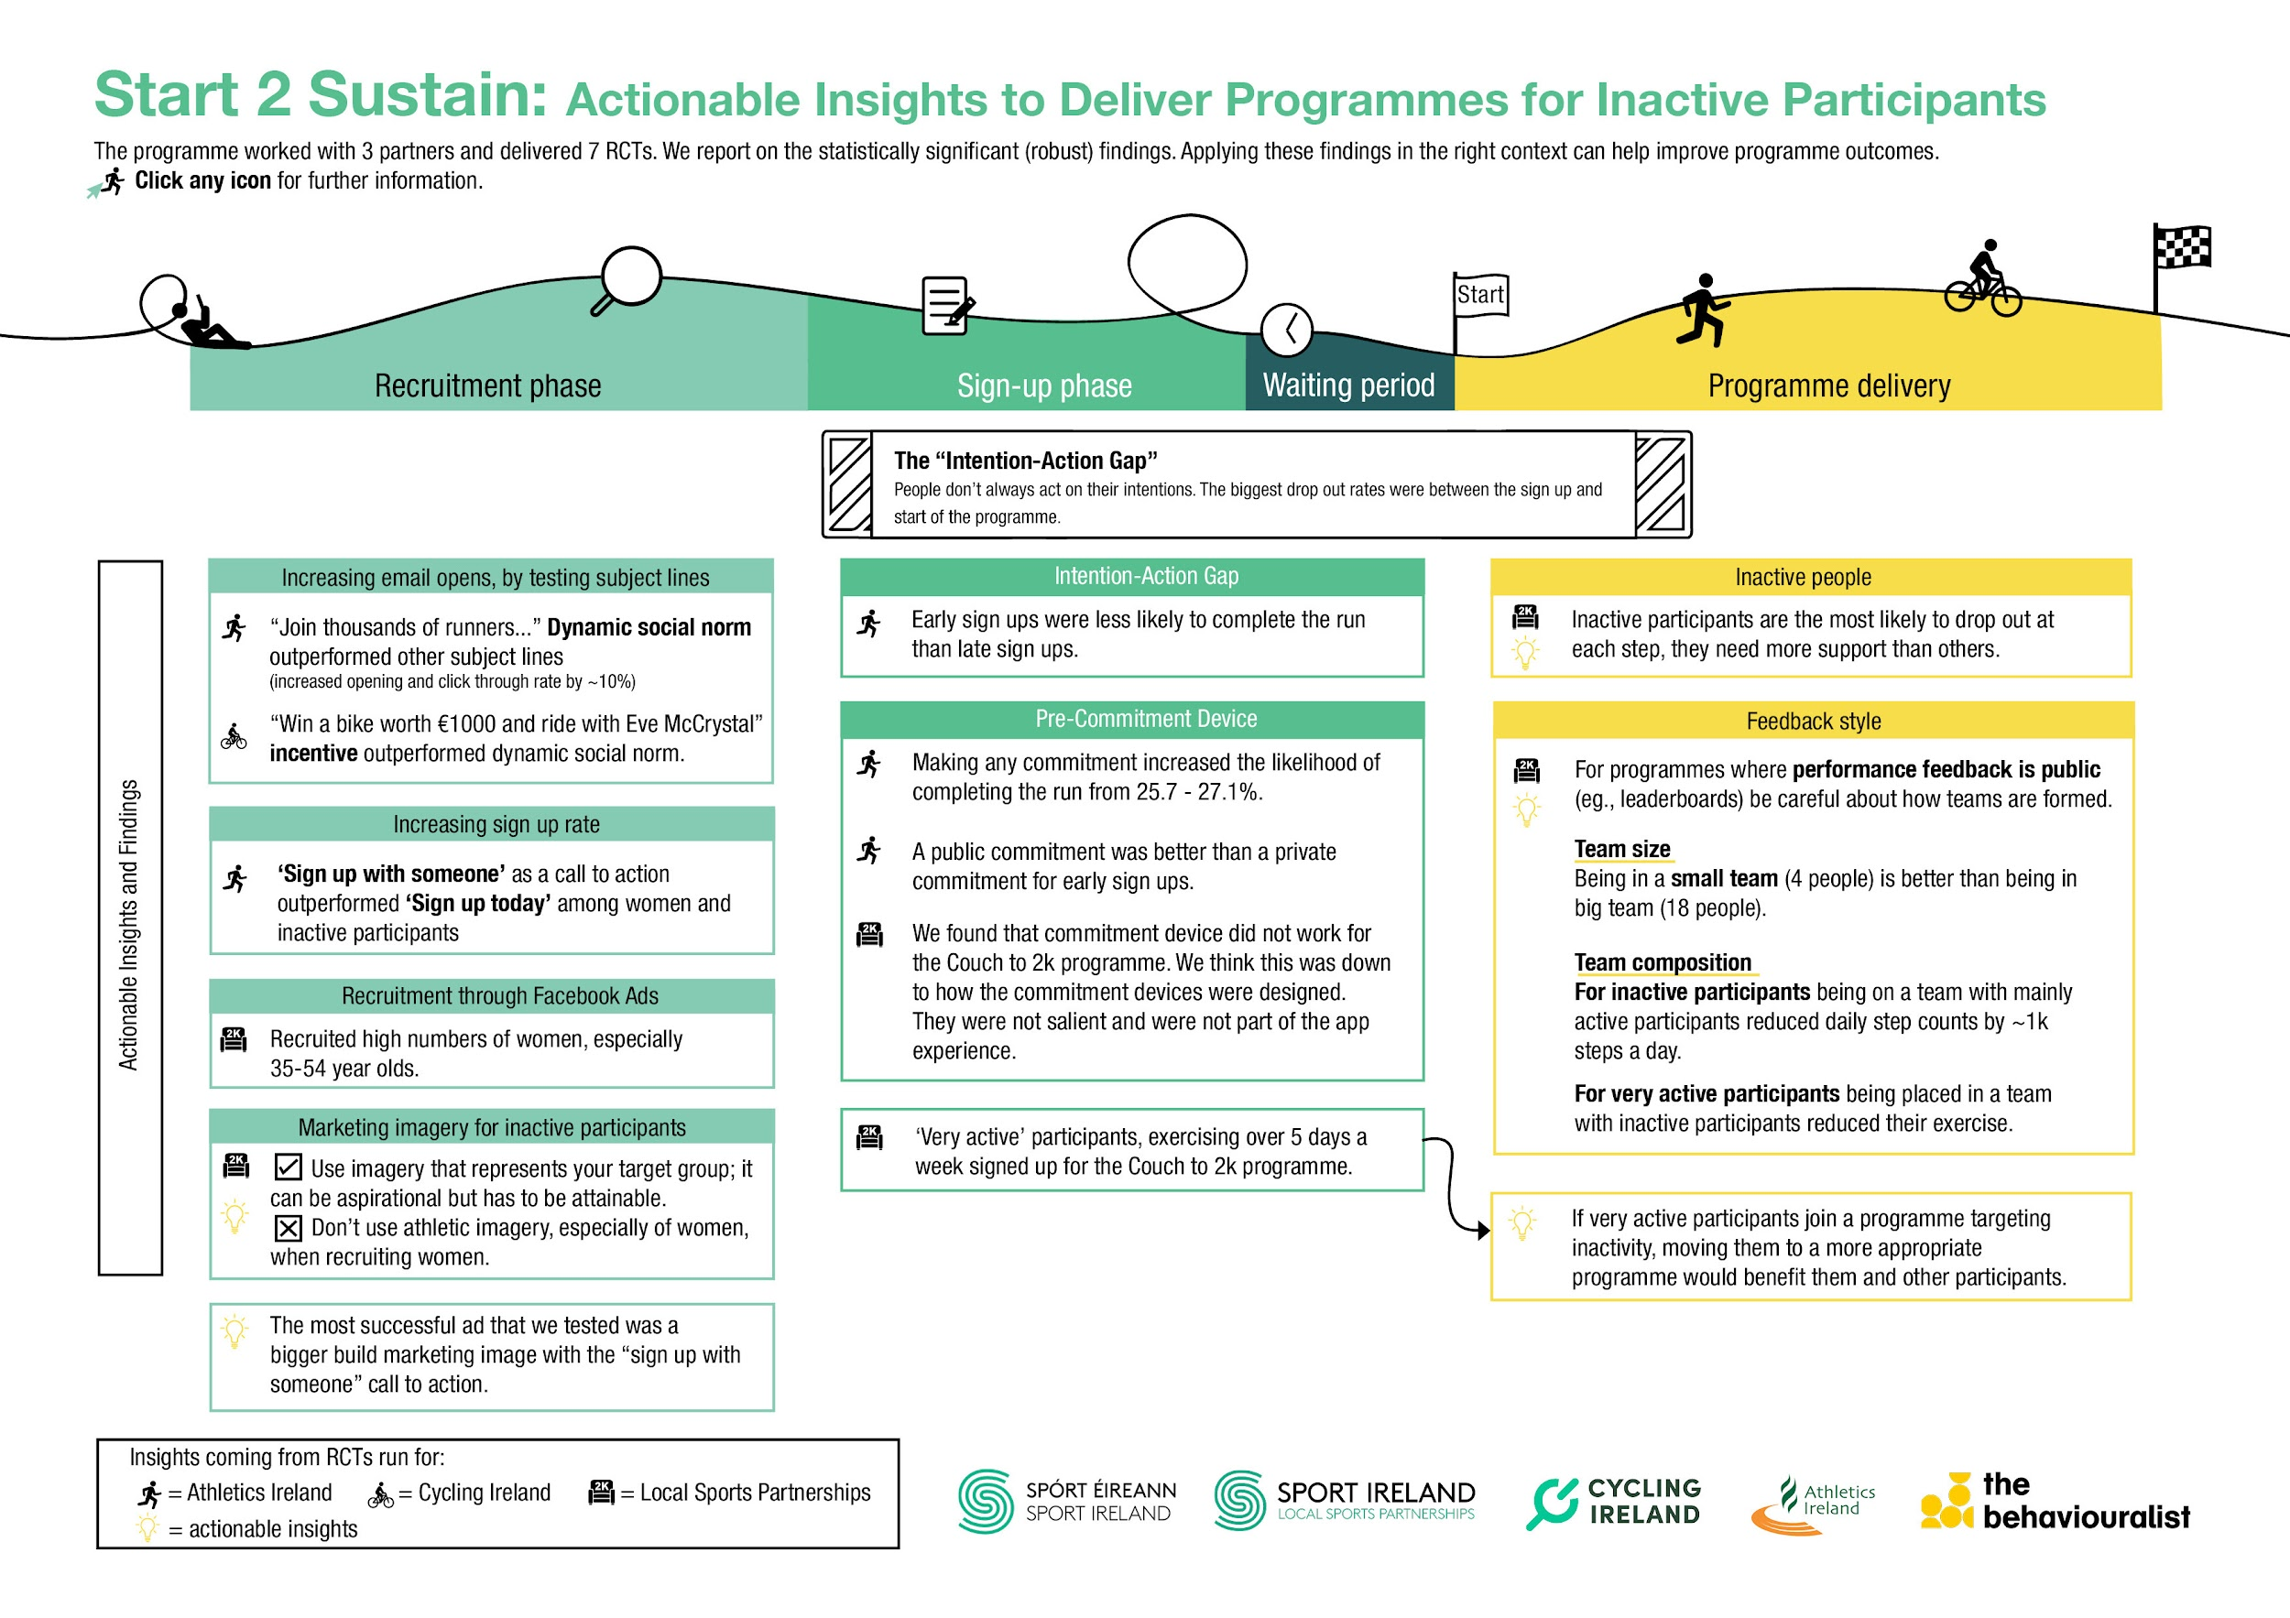

Slide 7

Inactive participants
Were more likely to drop out across the programmes.
Truly inactive (0 days exercise) participants were more likely to drop out than (1 days exercise).
Intention - action gap (48%) drop-out that needs to be bridged (Meta analysis 46%)
Inactive participants need more support and extrinsic motivation.
Notes:
Emphasise support experience – effort to maintain engagement.
Need to feel welcome
Significant results – 95% / 99% certainty.

Slide 9

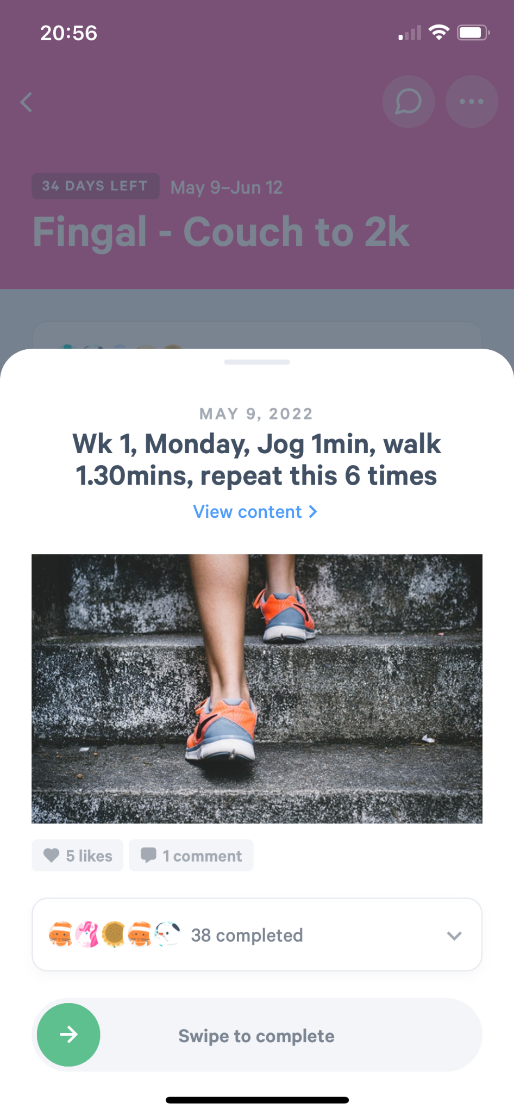
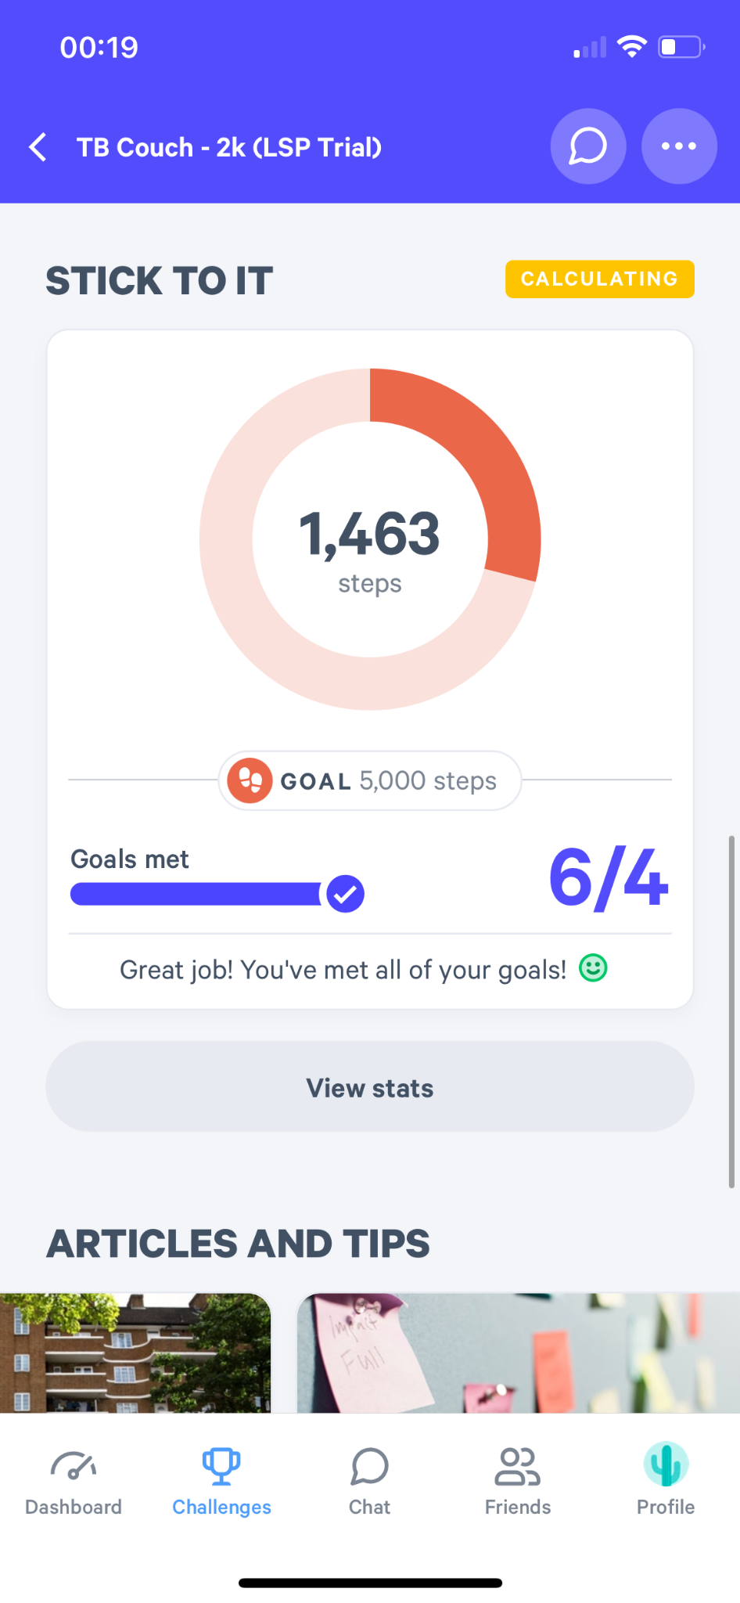
F
Couch - 2k,
  5wk programme, 3 exercises in a week.
  Virtual programme - no face to face exercises
Adults only
MoveSpring app (off the shelf app)
1200 participants signed up
35-54 / predominantly women
Inactive participants

Slide 10
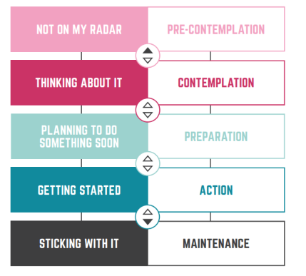
Target audience
Transtheoretical Model of Behaviour Change
Inactivity
Intention - Action Gap
Habit formation relapse

Slide 11


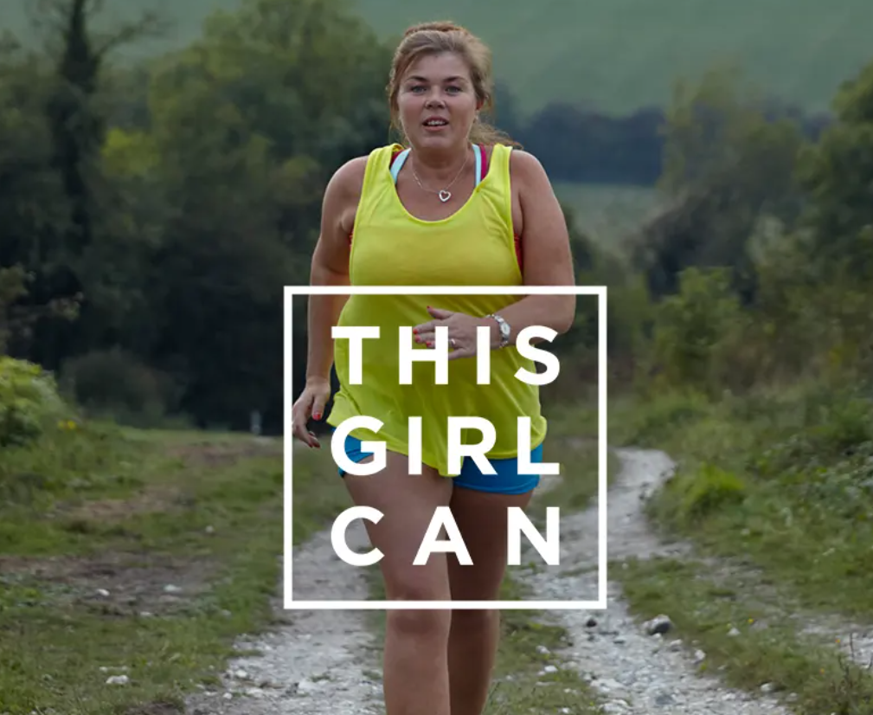
Marketing & retail
Identifiable
Aspirational
Notes:
REACH STOP CLOSE
Different strategies – creating images that are identifiable.
Increased purchase intent – especially if the BMI aligns.
Aspirational – often linked with products – concept being that by buying a product you associate with the image.

Slide 12
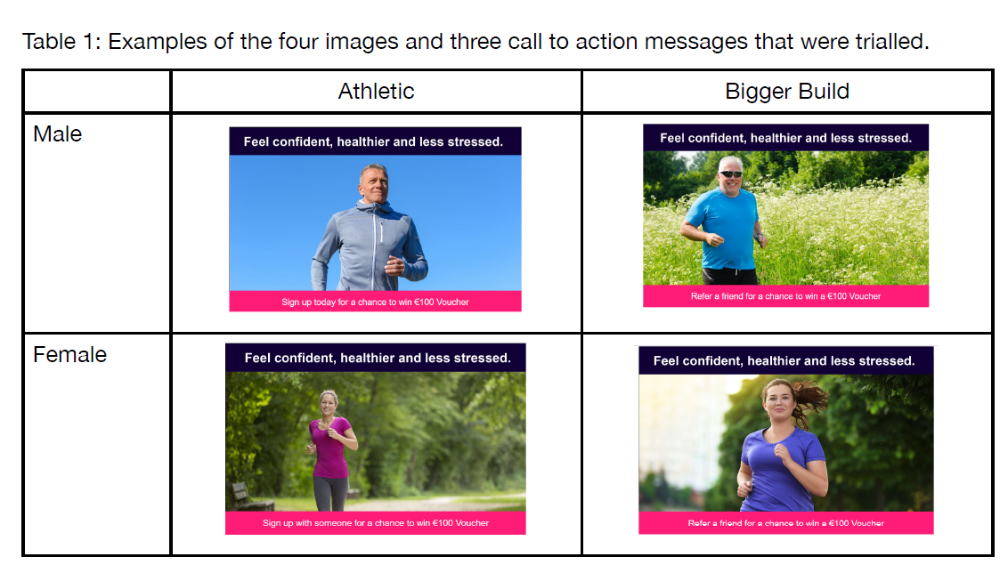
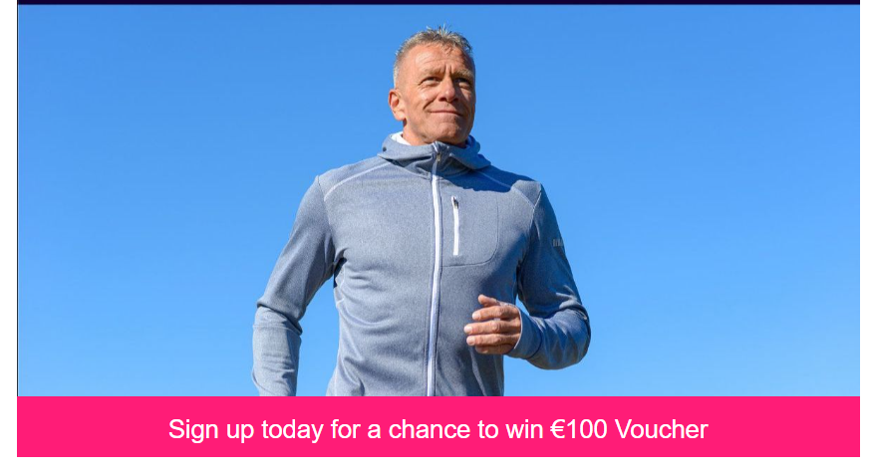
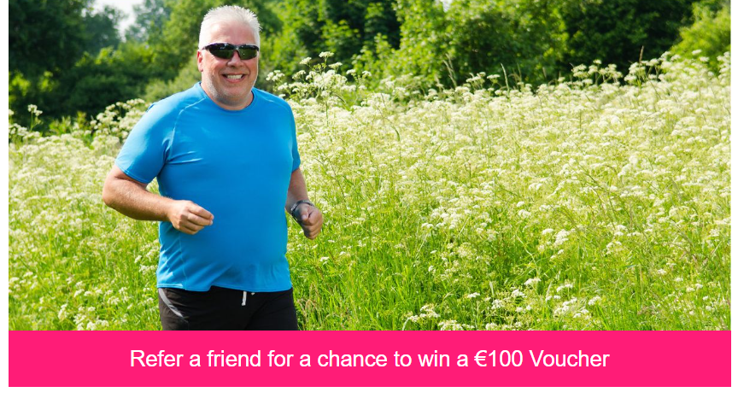
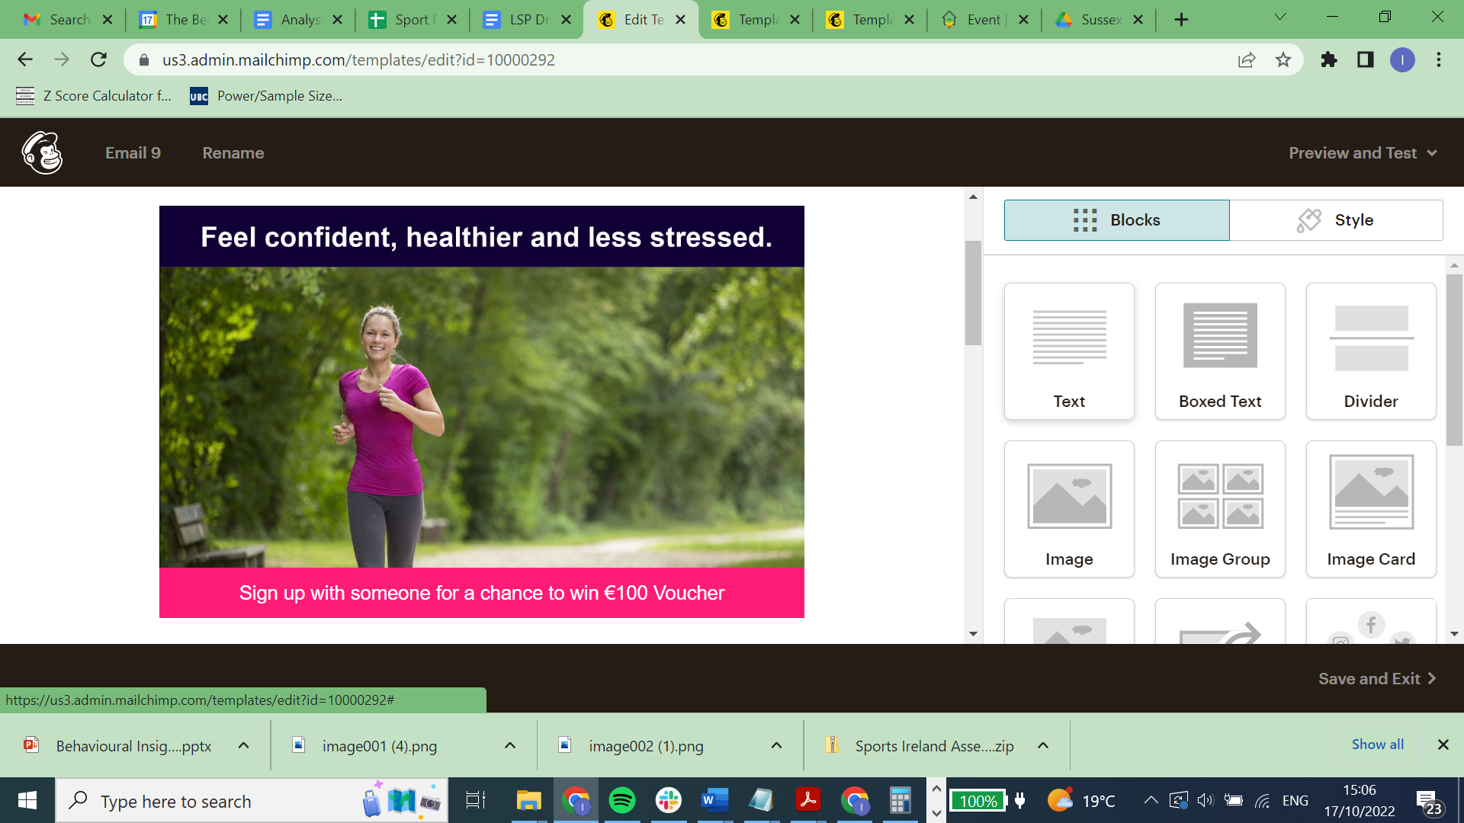
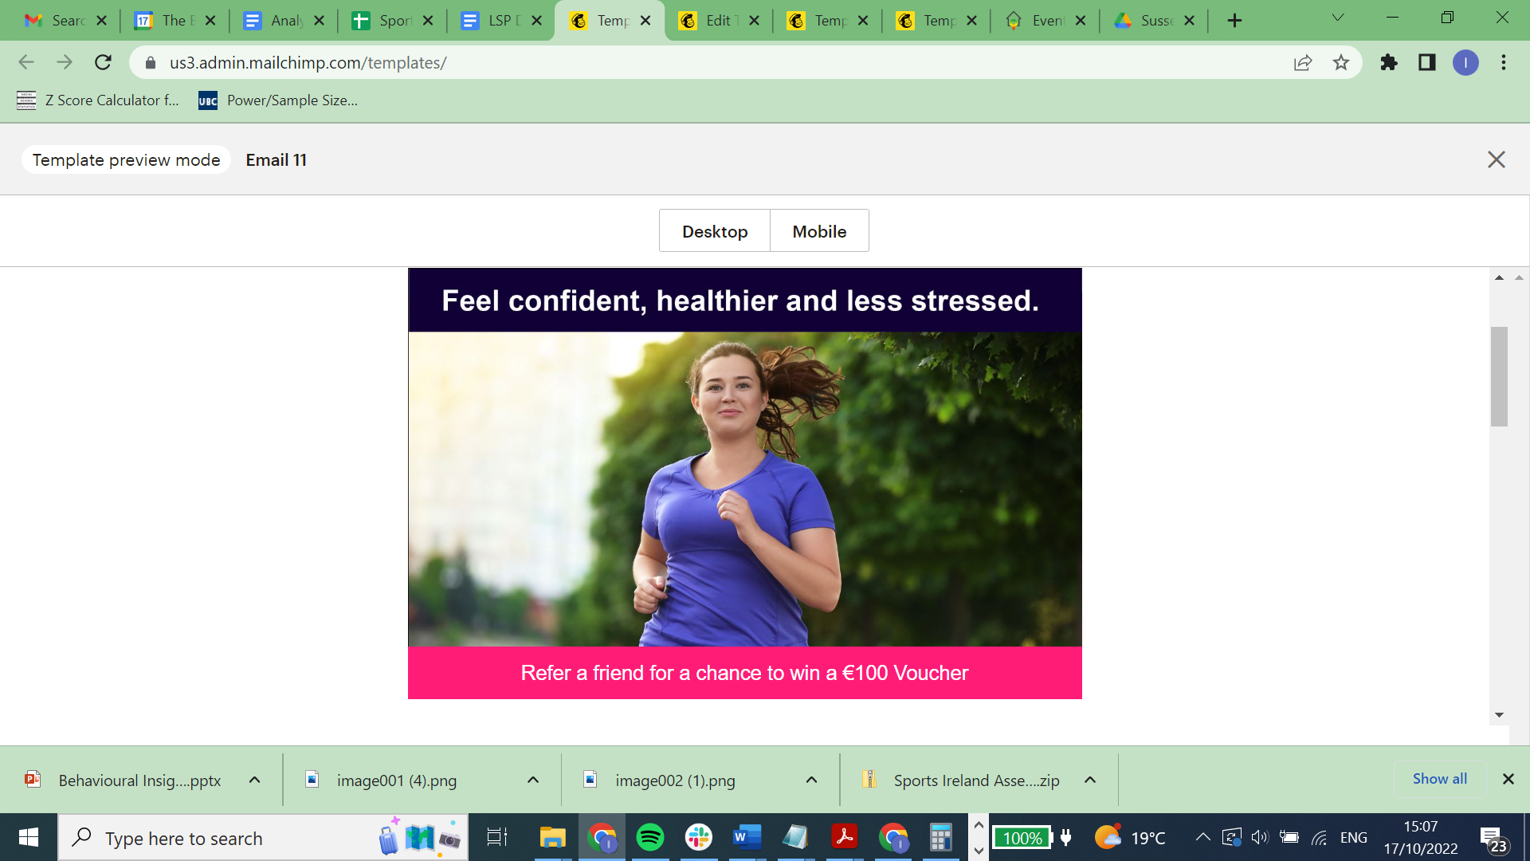
Recruitment
12 Ads Gender & Body type.
4 Images x 3 Call to actions.
Pre-tested images:
1000 members general public.
Email campaigns (10,531)
Facebook campaigns (49,660).

Slide 13
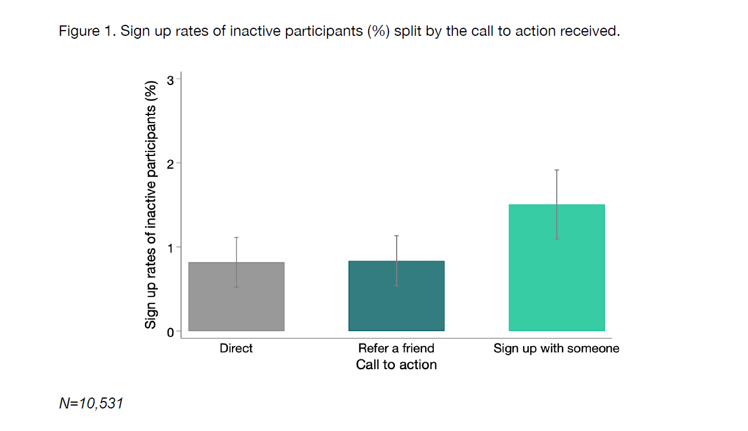
Make it social
The ‘Sign up with someone’ CTA was the strongest
a. A higher number of participants overall
b. A higher number of women
c. A higher proportion of inactive participants (increasing from 0.82% to 1.51%).
For inactive participants -‘Sign up with someone’
increase sign up > 80%

Slide 14
Be careful of athletic imagery
(for inactive programmes)
Athletic images had a negative effect on:
Starting the programme (downloading the app). Reduction from 2.43% to 1.79% (36% reduction)
No significant impact on sign up BUT
For ‘sign up with someone’ CTA
 | Male, Athl. | Male, BB | Fem, Ath | Fem, BB
Sign up rate | 3.6% | 4.4% | 2.4% | 5.2%
Sign up women | 3.2% | 3.5% | 2.1% | 4.6%
Download MS | 2.5% | 3.4% | 1.2% | 3.9%
Sample (N) | 832 | 877 | 915 | 765

Slide 15
Social identity theory (Tajfel & Turner)
Social Identity
Social Categorisation
Different social groups
“We”
(Non-sporty)
“They”
(Sporty)
In Group
Intergroup comparison
Out Group
Notes:
This has been leveraged successfully across park run -
Forming groups based around social identity - more engagement with programmes, increase the positive and negative influence of social norms.
Football fans ++
THE STRONGER PEOPLE IDENTIIFY WITH THE SOCIAL GROUP THE MORE THEY ARE INFLUENCED BY IT!

Slide 16
Recruitment takeaways
Emphasise the social aspect of the programme in the CTA
To recruit inactive women do not combine ‘sign up with someone’ with an athletic image.
Use imagery that is identifiable and attainable NOT athletic aspirational imagery (for inactive adults returning to sport)
Caveat: this only applies to the target audience and the context.
Further research
Different stages and audiences
Famous athletes - inspirational imagery vs general public
Varying imagery type as the individuals progress and develops

Slide 17
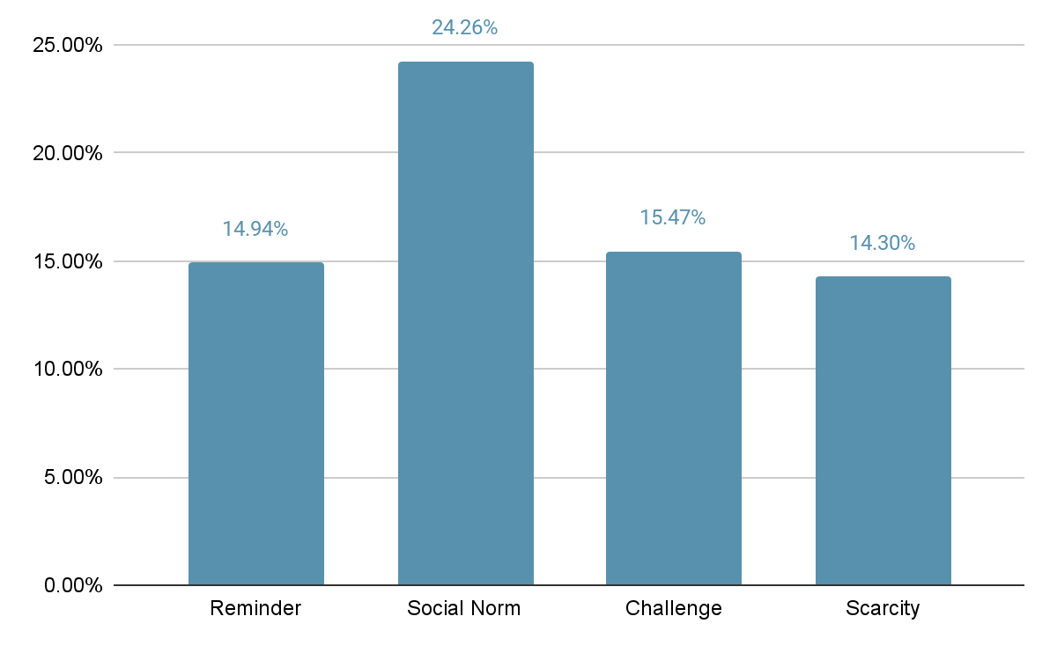
Email subject lines
40k email membership database
Subject Line | Copy | Open Rates
Reminder | 48 Hours To Go: 2021 Virtual Irish Runner 5 Mile | 14.94%
Social Norm | Join thousands of runners for the Virtual Irish Runner 5 Mile | 24.26%
Challenge | Challenge yourself by running the Virtual Irish Runner 5 Mile | 15.47%
Scarcity | Last chance to sign up for the Virtual Irish Runner 5 Mile | 14.30%

Slide 18
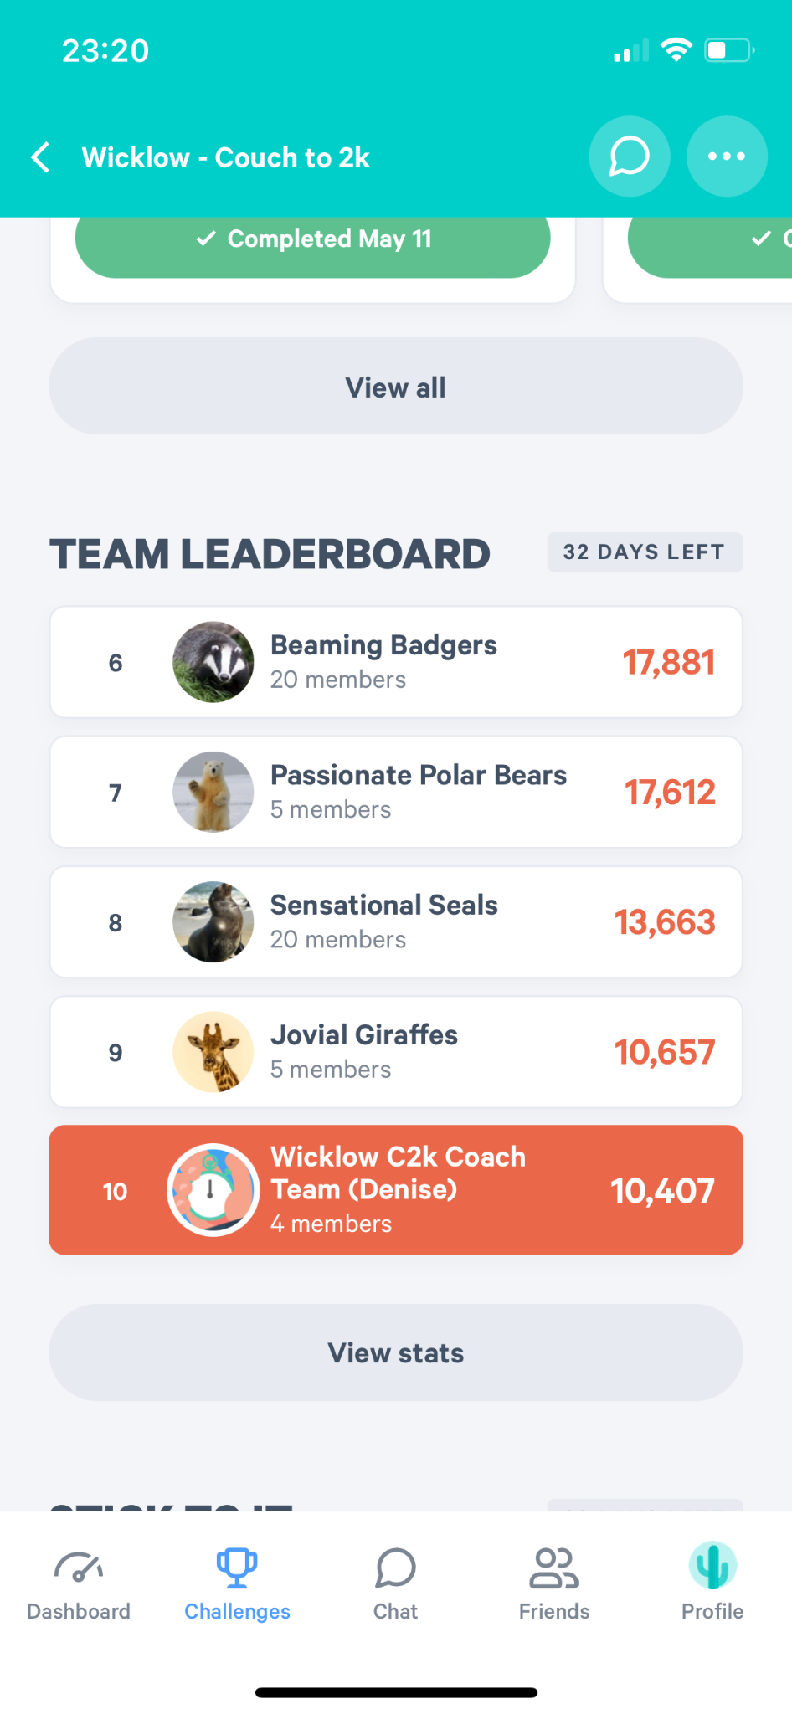
Teams
And the use of leaderboards
Background
Mixed ability groups have been shown to be of benefit in education settings (Linchevski & Kutscher, 1998)
LSPs - Peer mentoring occurring organically
Divided people into teams
Inactive > Active (161)
Inactive < Active (634)
Inactive = Active (68)
Total (863)

Slide 19
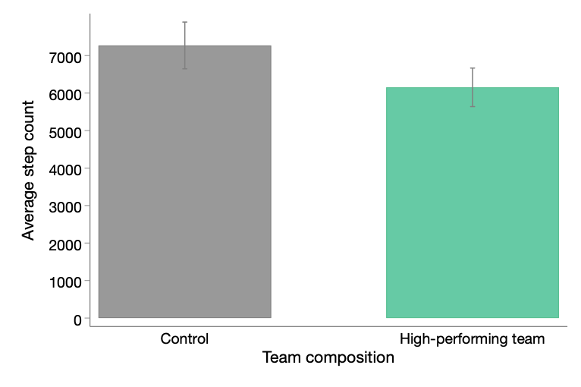

Results
Average daily step count for inactive participants
Mixed results BUT
Reduced step count of inactive participants by ~1000 steps per day.
*Caveats
Public performance (leaderboards)
Limited support from peers.
Table 3. Sign up rates for the four ‘Sign up with someone’ Ads
Leaderboards (public) increased attendance at the gym by 17% (BUT)
Those at the top increased pride and recognition, those at the bottom had increased shame.
Importance for membership retention.

Slide 21

3 ways behavioural science can help
A different perspective on existing challenges.
Insights and tools to help suggest solutions (Not a blue print)
Building an evidence base to share and scale across the sector
Opportunities to conduct cutting edge research – especially when you’re running large scale campaigns.

Slide 22

Thank you for your time
Ian@thebehaviouralist.com

Slide 23
Practical learnings
Positives
The appetite was there ‘I enjoyed the programme immensely’,
  Introduce in a usable / non-technical language
  Technical support on the evaluation approach
Value in mapping the participant experience (removing frictions) - (Behavioural science lens)
The sport sector is full of innovation, at a practical level - this could be tested and scaled
  Building evidence bases for what works / and what can be scaled
  Practical learnings - how to guides and strategy - e.g. upskilling on data management / how to guides on RCTs.
Challenges
Quality of data available in the sector - objective data can be a challenge.
GDPR challenges - data sharing agreements, with multiple partners.
Research (walk to jog / user devices)
Work with the grain there are opportunities to run large scale trials - don’t reverse engineer the research opportunity. Large scale present a learning opportunity.
Importance of Sport Ireland as a supporter and trusted sponsor

Slide 24
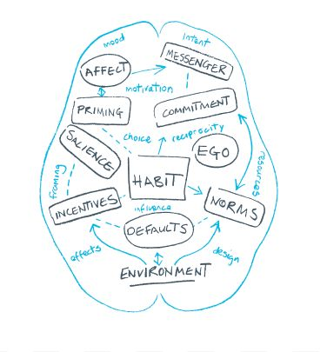
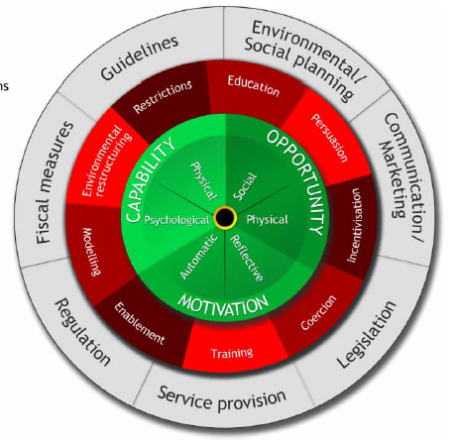
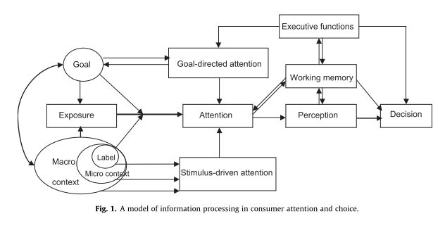
Frameworks and theories
Routine
Cue
Reward
MINDSPACE
Behaviour Change Wheel (COM-B)
Attention / Cognitive models
Habit
formation

Slide 25
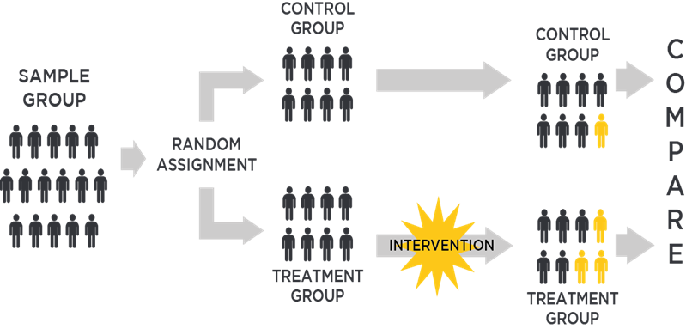

Behavioural Science can help
Randomised Controlled Trials:
Establish causality
Measure effect size (impact)
Build knowledge base - what works
Conduct heterogeneity analysis
Require large sample sizes
1) Providing insight and tools to address challenges
(e.g. inactivity, sustainability +)
2) Provide Theories of Change to understand challenges from a behavioural perspective.
3) Introduce robust evaluation methods, evidence based. Build a knowledge base of what works within the sector. Enables sport to share and scale learnings.

Slide 26
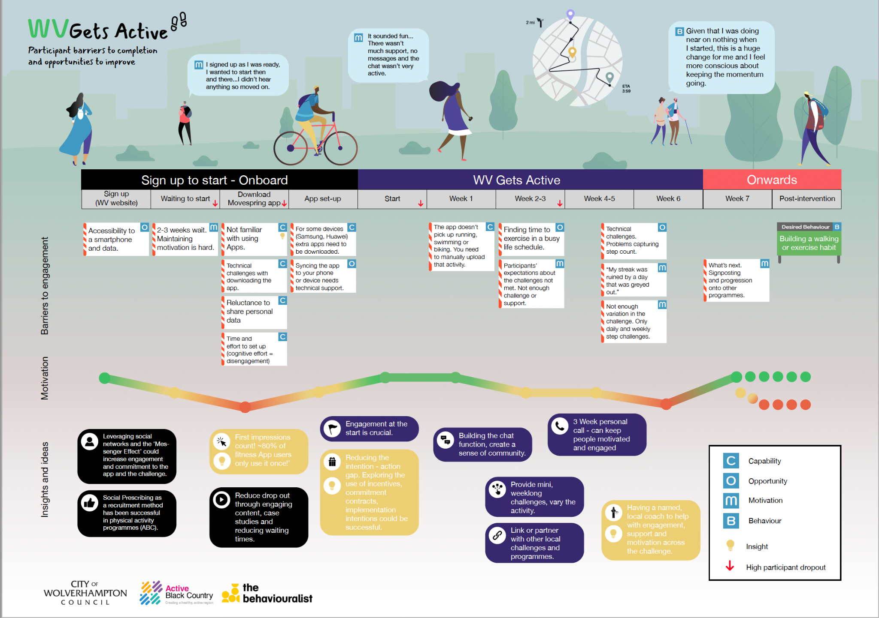
Behavioural journey mapping
Map the participant experience
Break down steps into component actions
  Barriers and enablers
  Identify opportunities to intervene

Slide 27
Tools (prompt cards)
Heuristics
Availability Heuristic
Representativeness Heuristic
Loss aversion bias
The Endowment effect
Framing effect
Mental shortcuts, rules of thumb
Present bias
Social Proof
Affect Heuristics
Recognition heuristic
Scarcity heuristic
Cognitive biases
Confirmation bias
Optimism bias
Bias blind spot
Anchoring effect
Herding instinct
In-built systematic biases on judgment and decision making
Omission bias
Bandwagon effect
Familiarity heuristic
Authority bias
Default bias

