Slide 1
Prime Ministry
State Secretariat for Active Hungary
Szekeres Lilla
19 October, 2023
Central and Eastern European Health & Fitness Summit, Prague
lilla.szekeres@me.gov.hu

Slide 2
HISTORY
State Secretariat for Sports
Focused on elite and competitive sports
2016
Government Commission
For the development and promotion of cycling and active recreation
2022
State Secretariat for Active Hungary
All the recreational sports,
active turism, cycling
State Secretariat for Sports
Focused on elite and competitive sports

Slide 3
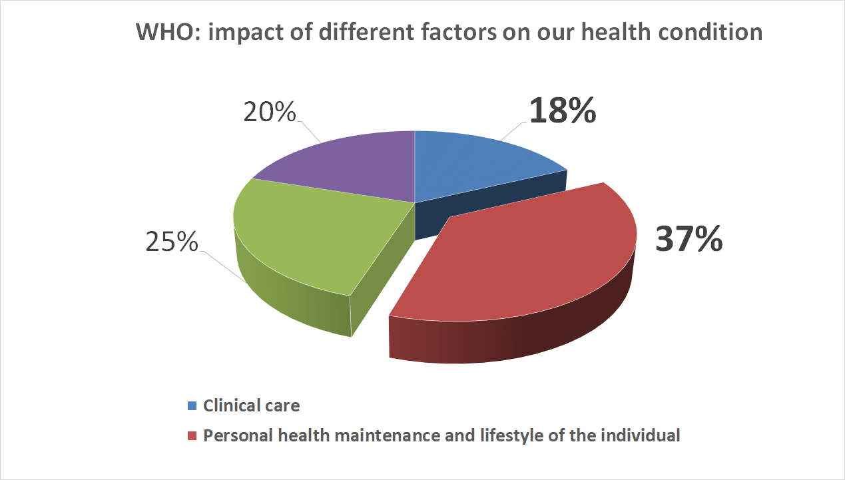

Slide 4
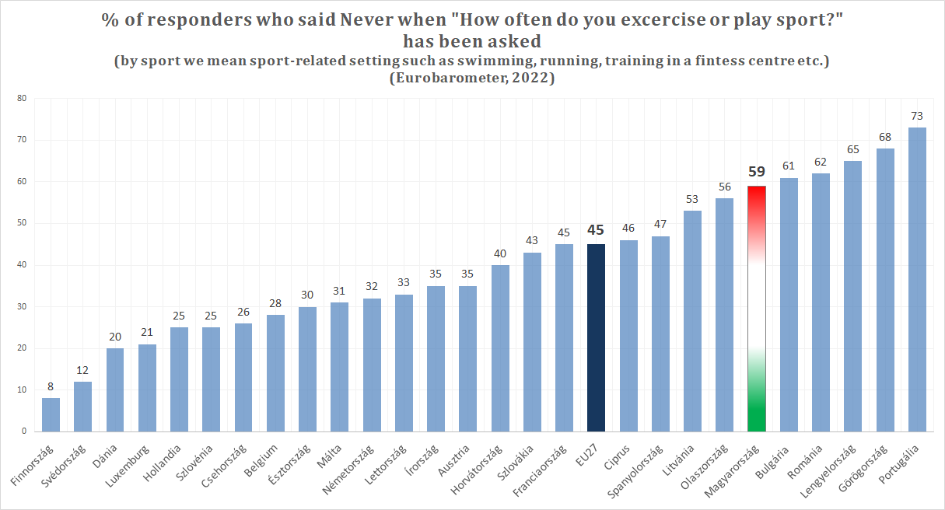
Hungarians move dramatically little…
Never: 59%
Rarely: 15%
Total: 74%
…¾ of the population…

Slide 5

The lack of physical activity causes 13 000 mortalities / year in Hungary
9,7% of the mortality comes from sedentary lifestyle
Approx. 37 persons/day

Slide 6
Physical activity is the solution!

Slide 7
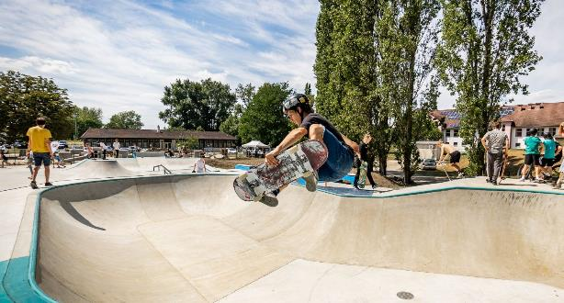
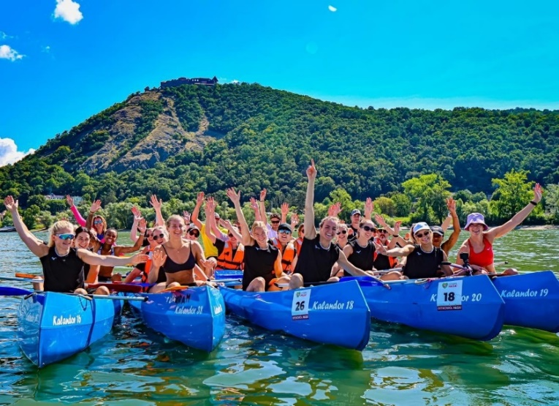
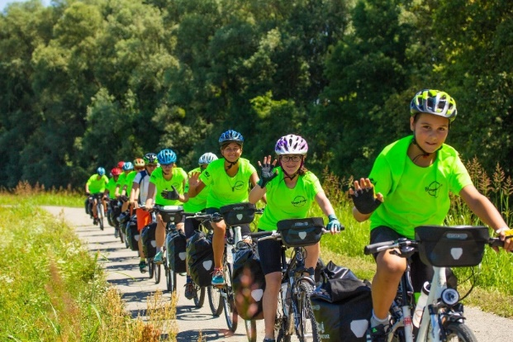

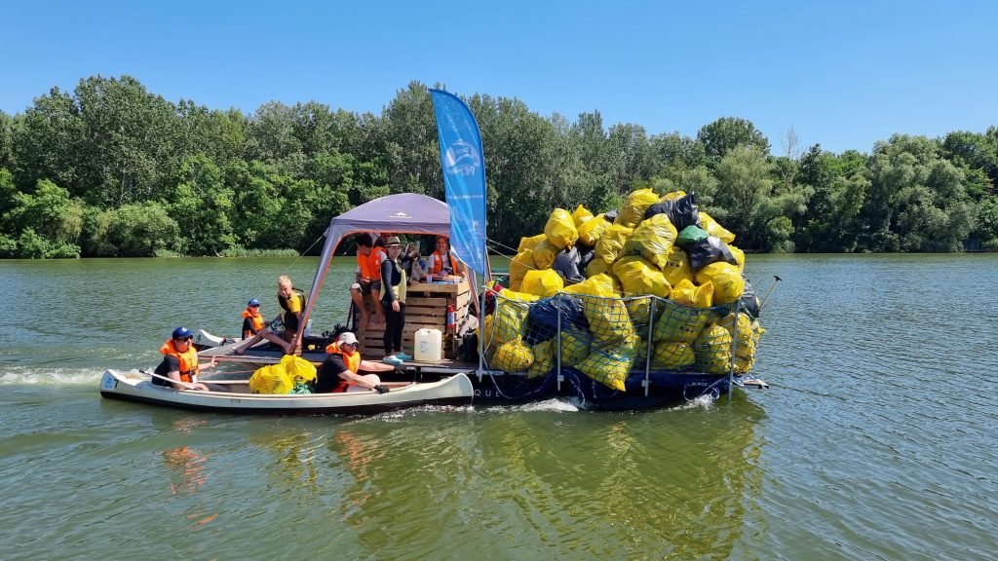
Our programs:
Cycling parks
Skatepark program
Ski course program
Building and repairing
indoor climbing rooms
Active school trips
Installation of orienteering fields
PET Cup – for high schoolers
Adventure Camps (hiking, cycling, rowing, pilgrim)

Slide 8

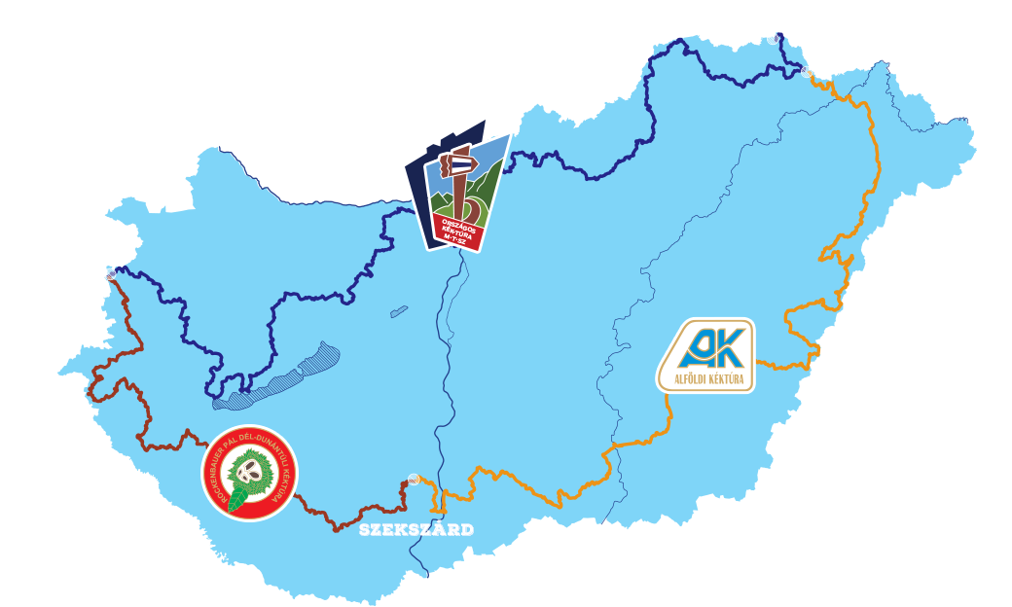
Million steps for your life & for your school in 11 weeks
Anybody can be involved
+ New element: The Elderly
Currently: 322 000 participants

Slide 9
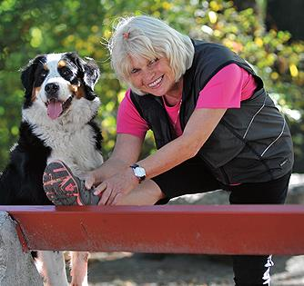
In progress: Active Lifestyle Strategy
State Secretariat for Active Hungary + Hungarian University of Sports Sciences
Preparation, professional consultations
Areas of intervention (workplace, children, healthcare, elderly, disadvantaged etc.)
Monspart Sarolta
World Champion – orienteering
Hungarian Champion - cross counrty skiing
First woman in Europe who did the marathon in 3 hours

Slide 10
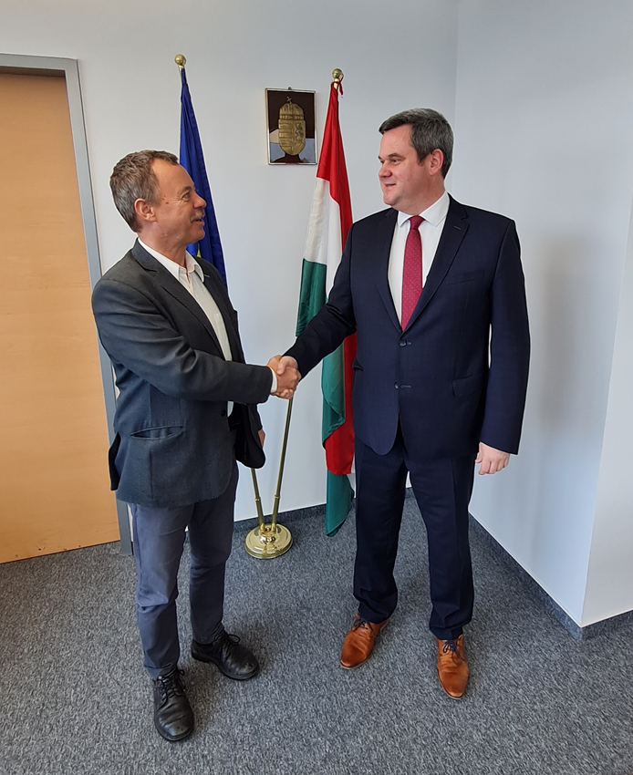
Goal: reduce the number of the people who never do sports by 15 %
Joint task: collaboration of healthcare, education, sports, workplaces

Slide 11


HOW?
Public health product tax

Slide 12
Public health product tax
Since 2011. 09. 01.
Soft drinks, energy drinks, sweets, alcoholic refreshments, stuffed pastas etc.
Compulsory, but optional to offer a certain part of it

Slide 13
Public health product tax
Until 2023
From 2023
National Pharmaceutical and Food Health Institute
State Secretariat for Active Hungary
Programs that promote physical activity and active lifestyle
Max. 10% of all the tax paid

Slide 14
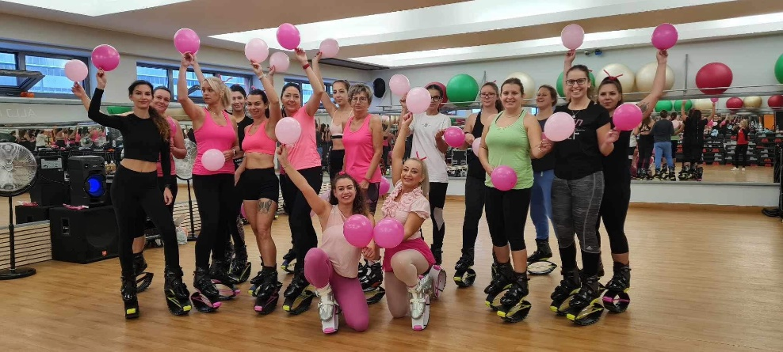
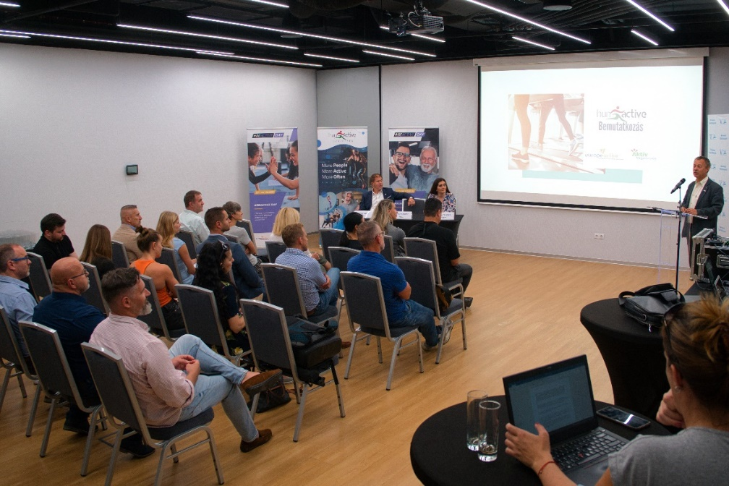
Collaboration with the fitness sector
Plans:
Measuring the situation
Strengthening the relationship
Involving the sector in strategy making
Prescribing physical activity
Establishing a trainer register system
Developing a health ambassador system

Slide 15
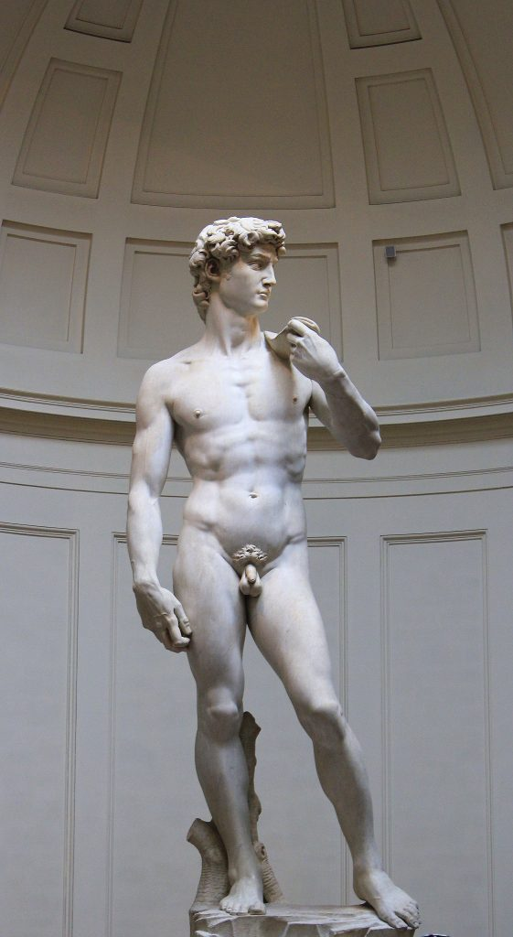
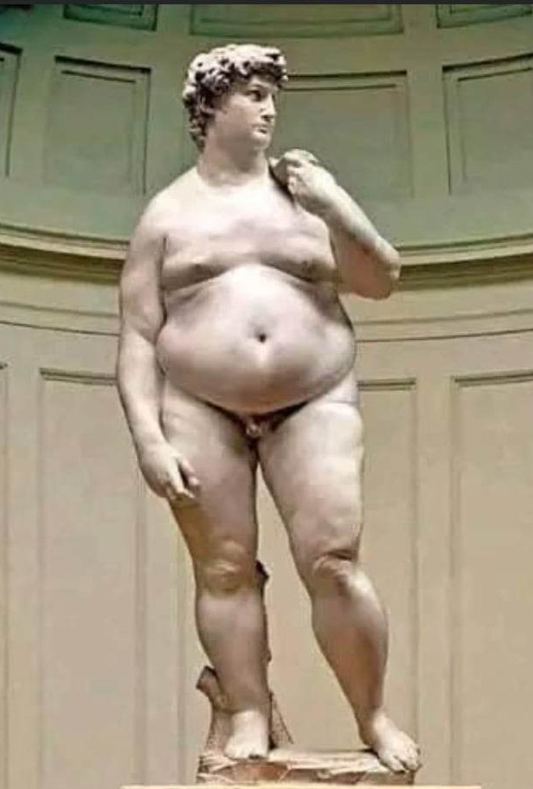
The statue of David after the renovation in the XXI. century

Slide 16
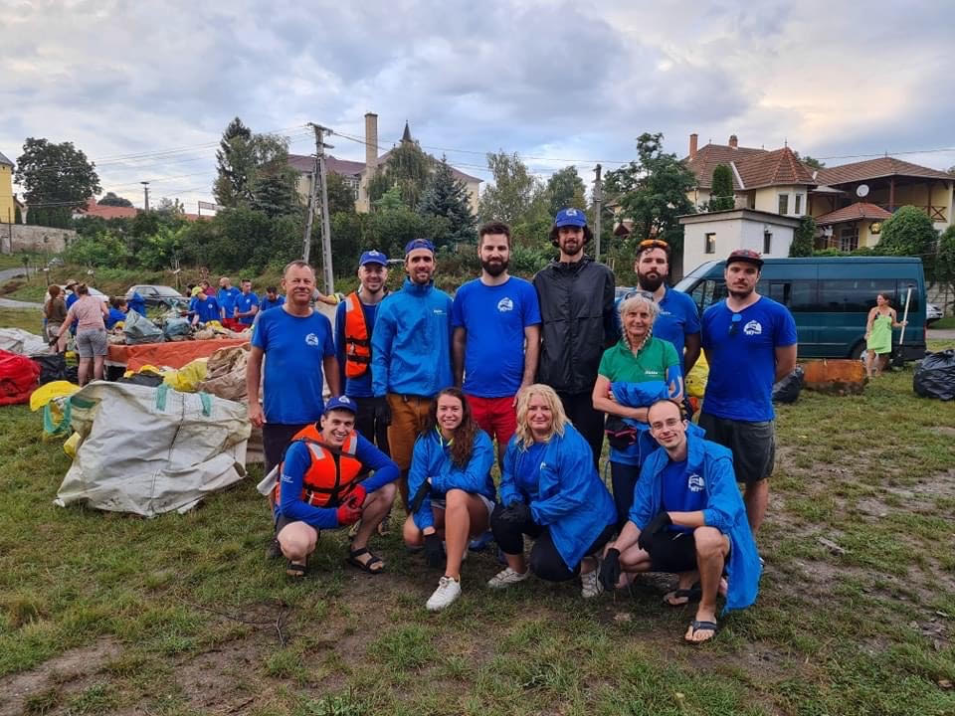
„ Those who are crazy enough to think they can change the world usually do.” - Steve Jobs
Thank you for your attention! ☺
Szekeres Lilla
lilla.szekeres@me.gov.hu

