Slide 1
CENTRAL AND EASTERN
HEALTH&FITNESS SUMMIT
Prague, October 2023
Patient Perspective
Exercise specialist, are we ready to take a leap?
Veronika Všetičkova
Patient Advocate – EU Policy and Advocacy
Physiotherapist
Head of EU Affairs @ELPA
Mentor @Slovenian Fitness Association

Slide 2
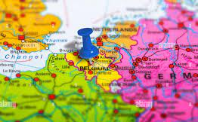

Slide 3












Slide 4

BURDEN OF NCDs IN EUROPE IS ON THE RISE
Diabetes, cardiovascular diseases, obesity, obesity among children, liver diseases, mental illnesses...
***Non-communicable diseases are diseases that are not spread through infection or through other people, but are typically caused by unhealthy behaviors. They are the leading cause of death worldwide and present a huge threat to health and development.

Slide 5
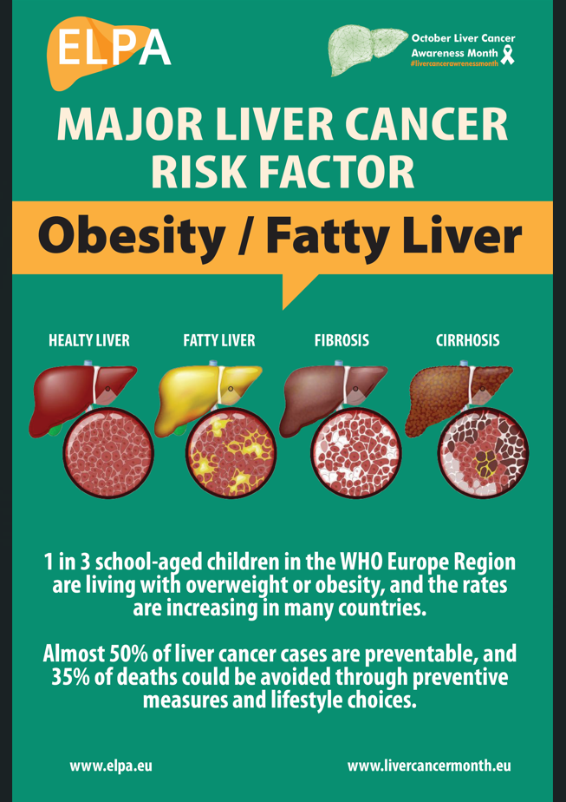
- Prevalance = 35% in EU (children, adults in Europe)
- No drugs/no treatment
- Obesity, Type2Diabetes, lack of PA, inflammation, gut disbalance
Reversable, if detected on time!

Slide 6

Scientific Guidelines for fatty liver disease
(and other NCDs):
- 10% body weight reduction
- healthier diet (Mediterranean diet)
- regular PA (3-4 times/week & adjusted)
Healthy lifestyle intervention!
70%
of liver patients confirmed that it is very hard/impossible to follow suggested behaviour changes to improve their condition.

Slide 7
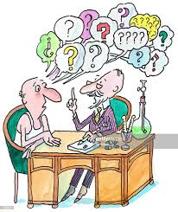

PREVENTION
TREATMENT (EARLY STAGE)
QUAILITY OF LIFE OF PATIENTS
We need you!

Slide 8
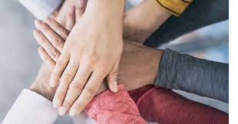
Exercise specialists,
are we ready to take a leap?
  Can fitness community with its established enviroment and network plays pivotal role in NCDs pandemic?
  Is the community mature enough to collaborate with medical community?
  Do they have enough human resources, capacity are they ready or at least willing to join forces and perhaps to some extent merge with national health system coverage?

Slide 9
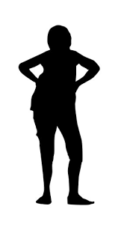
Fitness as a part of the health care solution =
PERSONAL SERVICE AND TEAM APPROACH TAYLORED TO PATIENT NEEDS!
KNOW YOUR CLIENT!
PHYSIOLOGICAL
ASPECT
Age
Sex
Condition/stage of a disease
Recovery time
Limitation/disabilities
PSYCHOLOGICAL
ASPECT
Motivational triggers
Habits
Emotions/Values
Self-confidence
Self-image

Slide 10
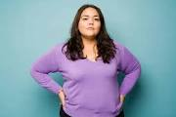
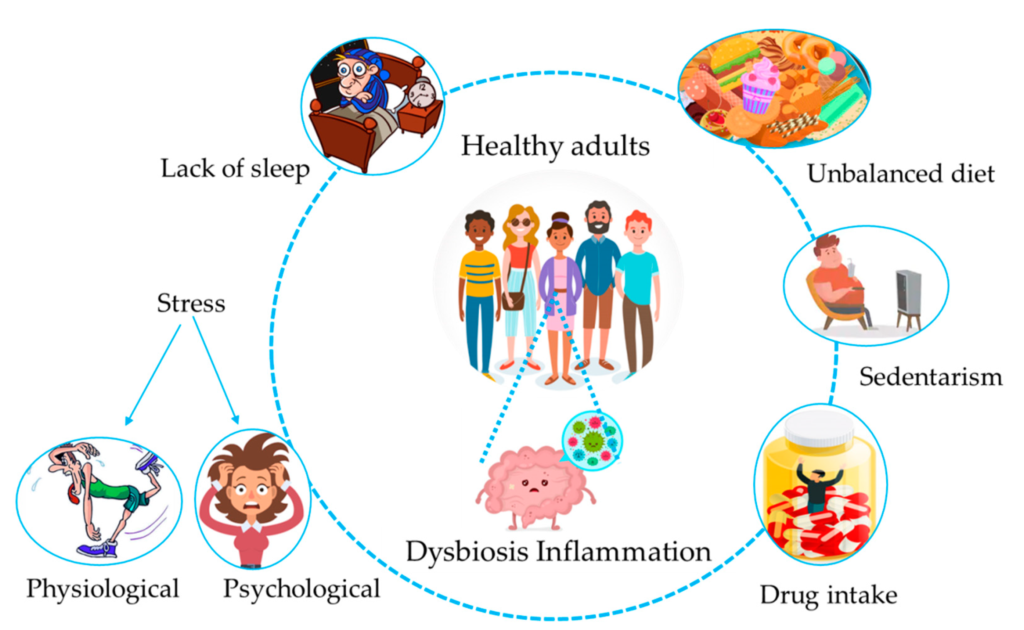

Example:
Susane, 39 years old, mother of 2 toddlers, CEO, fatty liver, obesity, diabetes, stressful and sedetary lifestyle
1. First impression is the key. Make it or break it!
Communication (External and internal)
Enviroment (Closed space for dialogue, body measurements, ...)
2. Experts/Specialists (Myths about fitness and gyms)
Holistic and individual approach (separation from online self- called experts)
3. Coordination/handling (lead the patient, never leave him/her alone, small talk)
4. Make them feel welcomed and seen!

Slide 11
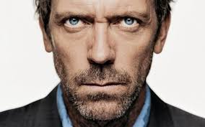
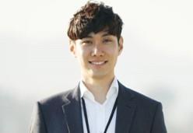

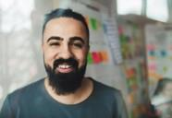
Clear guidelines and standards are needed!
Multidisciplinary team - Magic triangle?
PA expert, nutritionist, psychologist
SPECIALIST​​
Exercise specialist​​
NUTRITIONIST​​
PSYCOLOGIST​

Slide 12

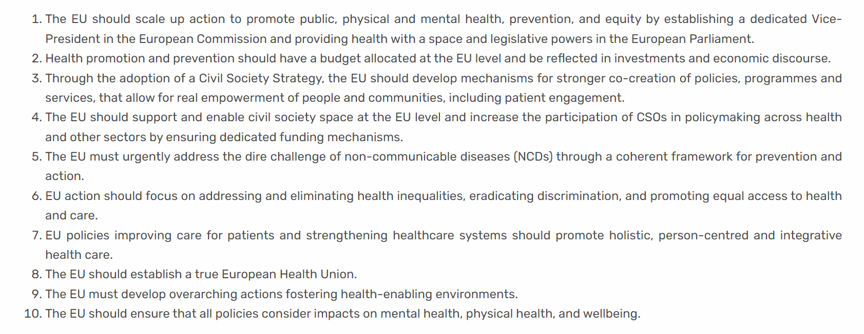




Slide 13
Take home messages
Are we ready to collaborate?
Keep building on the current momentum. Not „what if“ but how exercise experts can become a part of public health solution in the scope of prevention and reduction of prevalence and incidence of NCDs.
Patient communities are calling for support with holistic and individual approach, preferably done by organized and connected multidisciplinary team addressing lifestyle management from physiological and psychological aspect.
We need more and narrow scientific papers, articles, congresses, materials proving once again the „potential“ of PA and fitness communities which will build better awareness among policy makers and civil society. We also need pilot studies, good practices‘ examples serving as ground for policy, advocacy and more EU funding opportunities.
Clear guidelines and „protocols“, set up by key-players/stakeholders, including „end line consumer“ – patients and civil society representatives.

